Slide 1








LTIMindtree Service Offerings
Cloud, Infrastructure
& Security
Enterprise
Solutions
Quality
Engineering
Data &
Insights
Cloud native services
EUC and helpdesk
Infra run & transformation
Data Centre migration, build
SOC Managed services
SAP, ECC, S/4, SOH, SF
Oracle ERP, Cloud
Industry solutions
Microsoft, SaaS & Cloud Apps
Support & Maintenance
Core testing
Test advisory
Specialized testing
Test automation
GDPR
Data & Analytics
Data modernization
Insights and Activation
Data Science & Engineering
Big data, and Gen AI
Interactive/Experience Transformation
Digital
Engineering
Connected
Solution
Platform
Operations
UI, UX, Customer experience CRM
Digital Marketing & Commerce
Immersive and cognitive
Enterprise Integration
Portals and content management
Experience Transformation
Connected Enterprise
Digital Product Engineering
Integration
LTIMindtree NXT (IoT, Industry 4.0 Solution Suite)
NxT Insights
WISA – Worker safety
Geospatial track & Trace
Insight Oriented Operations
Connected operations
Experience Operations
Smart Operations
Consulting I Implementation & transformation I Managed services

Slide 2





At LTIMindtree, we see the potential of AI playing out in three ways:
AI IN EVERYTHING
INFUSE AI IN EVERYTHING WE DO
EVERYTHING IN AI
FROM AI HYPE TO AI SCALE
AI FOR EVERYONE
EMOWERING PEOPLE HUMANIZING AI
AI-driven service delivery powered by knowledge fabric
Agentic AI, where machines resolve and fix the root cause of issues, and humans resolve exceptions
AI in all stages of the operations & forward engineering
Leveraging the best of AI innovations from product partners and platforms
Exploring and industrializing use cases to unlock business value
Fail fast innovation for faster time to market
Strong startup systsystem at the center of innovation
Persona based co-pilots (e.g., Trader, IT Analyst, Commodities Procurement Mgr., Plant Mgr., SRE engineer and many more)
Humanized AI for enhanced user productivity and experience
AI democratization to benefit all
$4.3 Bn
Revenue
84,500+
Employees
35+
Countries Presence
750+
Clients
100+
Fortune 500
Clients

Slide 3



Ips and Acclerators
DecisionCX
Data Commerce for the Unlimited Enterprise
AI Driven , Insights Fueled Software Delivery Acceleration
End-to-end cloud life cycle management
Customer 360 for hyper-personalization
NxT
REDAR
POSmart &
TradeSmart
APEX
Connected
Platforms
eCommerce
Insights
Assortment
Planning
Demand Signal Repository &
Trade Promotion ROI

Slide 4



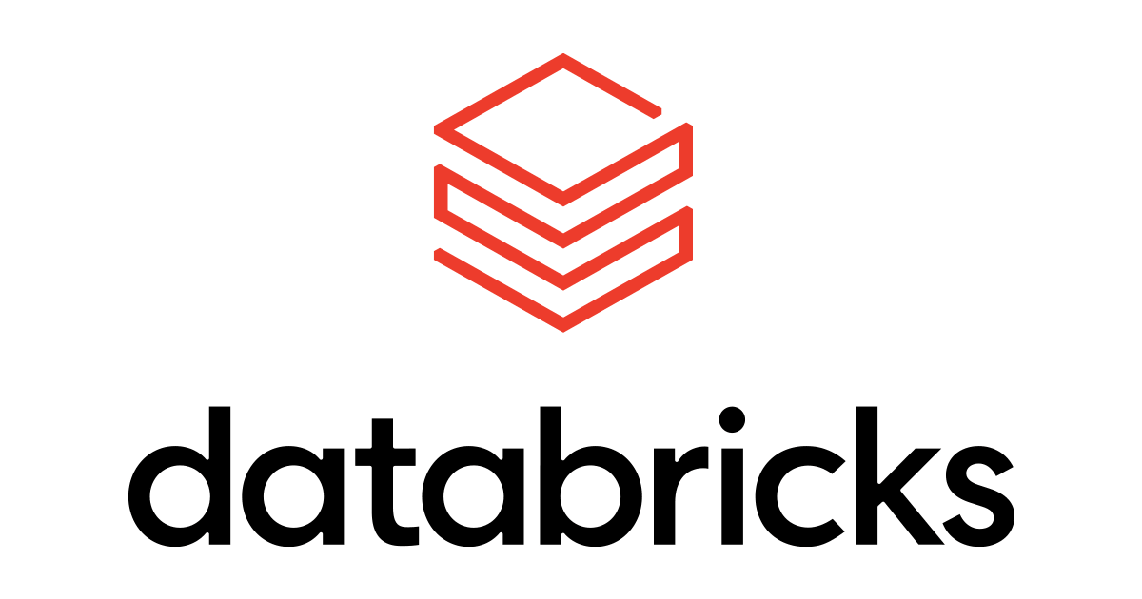
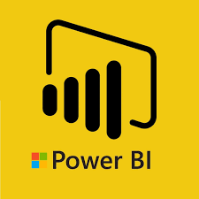














Data & Analytics Services: Our Capabilities
12,000+
Data & Analytics Professionals
15+
Technology COEs
180+
Global
Customers
500+
Years of R&D Effort
150+
Tools and Accelerators
Data Modernization & Engineering
Advanced Visualization
Business Analytics
Data Sciences & Engineering
Internet of Things
Data Consulting
  Cloud Modernization
  Next Gen. Data Management
  Master Data Management
  Data Mesh –
  Building Data Products
  Inferential
  Interactive Self-Service BI
  Smart Narrative
  Enterprise Data Management
  XOps & Service delivery mgmt.
  Insights Delivery @Scale
  AI / ML / DL
  Sales & Marketing Analytics
  CPG Analytics
  Platform and Device engineering
  Application from Edge to Experience
  Operations and Support
  Data Strategy & Architecture
  Pervasive AI Strategy
  Data ecosystem Transformation
Data Focused Acquisitions
Analyst Recognitions
Recognized as Leader (US) in Data Analytics and ML in ISG Provider Lens AWS – Ecosystem Partners 2020 Report
Recognized as Leader (US) in Consulting and Integration in ISG Provider Lens IoT - Services and Platforms 2020 Report
Our Partners

Slide 5










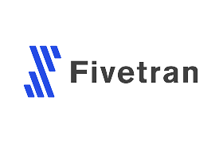





Enterprise AI Practice – Gen AI at LTIMindtree
Business Transformation & Acceleration with GenAI
LLM Evaluation (Patent Filed) & Adoption Frameworks
AI Strategy & Consulting
Platform Engineering
Custom LLMs & Cognitive Services for L&T Group
Applied AI & Data Sciences
ModelOps
(MLOps & LLMOps)
Trust and Responsible AI
AI
SERVICES
AI
RESEARCH
Constitutional AI & AI TORQ Framework for Trust in AI
Large Action
Models
AI First DNA
Innovation-led Value Realization
3,000+ Consultants in AI
Predictable, outcome-based services-as-a-software approach for quick value realization of GenAI
ENGINEERING
DNA
Niche AI
Talent
27,000+ GenAI Trained associates and 12,000+ Data professionals
GARUDA (Generative AI Ready to Use Digital Assets) Ed-Tech Platform for Training & Enablement
Products-led Monetization
Recognized as ‘The Best firm for Women in Tech’ 2023 by Analytics India Magazine
Recognized as a Top Employer in the UK for the third time in a row (2023)
Data-to-Decisions Product suite enabling Data Commerce for unlimited enterprise
Key Partnerships & Alliances
Finalist Partner of Year : Azure AI and Business Transformation
Launch partner of Bedrock AWS Gen AI Platform
Premier Partner Specialization in Data & Analytics
2023 Databricks Partner Champions of the Year
Elite Partner : Launch partner of Gen AI services
GSI Partner
Winner of GenAI Business Applications using SAP BTP

Slide 6






















LTIMindtree Overview - Expertise @Scale
We bring the unique strength of our organization to provide “best in class” end-to-end IT services support to Five Below
REVENUE
EMPLOYEE
STRENGTH
DIGITAL
REVENUE
GLOBAL
CLIENTS
GLOBAL
PRESENCE
$4.3B+
84,500+
45%
750+
100+
Capabilities across IT, engineering & digital
Your Digital Transformation Partner
100+ Fortune 500
Clients
Locations across 30+ countries
Banking & Financial services
Insurance
Retail, & Consumer goods
Manufacturing
Energy
Hi-Tech
Utilities
Media & entertainment
Health
Life
sciences
Awards and recognitions

Slide 7





Our north star vision for VFC: From AIOps to AI-First
A paradigm shift for VFC
Based on our analysis of VF Services, LLC’s priorities, our experience in similar engagements and the current pace of advancements in AI, where both structured and unstructured information can be actionized, we believe VF Services, LLC has an unprecedented opportunity to leapfrog the traditional thinking and get a significant head start by embracing the AI-First future.
AI-First model
VF Services, LLC Knowledge Fabric powered knowledge graph built using structured and unstructured data (Day 1 readiness)
VF Services, LLC Knowledge Fabric powered Run AI Agents and Co-Pilots (Machines resolve problems, humans resolve exceptions)
Engineering Co-Pilots to turbo charge agile development and estate modernization (60% faster)
Business Co-Pilots for key personas to improve productivity, experience and outcomes
Democratized intelligence through continuous learning knowledge graphs (minimized SME dependence)
Traditional AIOps model
Works with structured data (CMDB, SOPs, etc..)
Siloed teams, federated SME knowledge
Manual document and SME dependent Transition
Automation led with limited AI
Incremental landscape modernization
AI enables a small number of IT personas

Slide 8






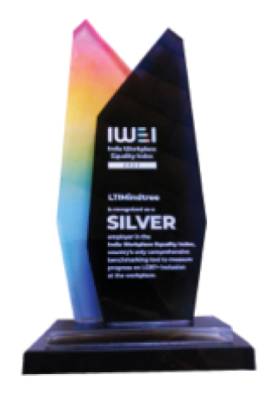


Key Recognitions
Analyst Recognitions
Sustainability & Workplace Recognitions
Gartner
2024
HFS
2023-24
Everest
2024
Niche Player- Outsourced Digital Workplaces Services
Retail & CPG Innovator
Major Contender CPG IT services
ISG
2024
Avasant
2024
ISG
2023-24
Leader -SAP Ecosystem
Enterprise Innovators-Manufacturing Intelligent Operations Services
Leader –
Sustainability & ESG
Gender Equality & inclusiveness

Slide 9
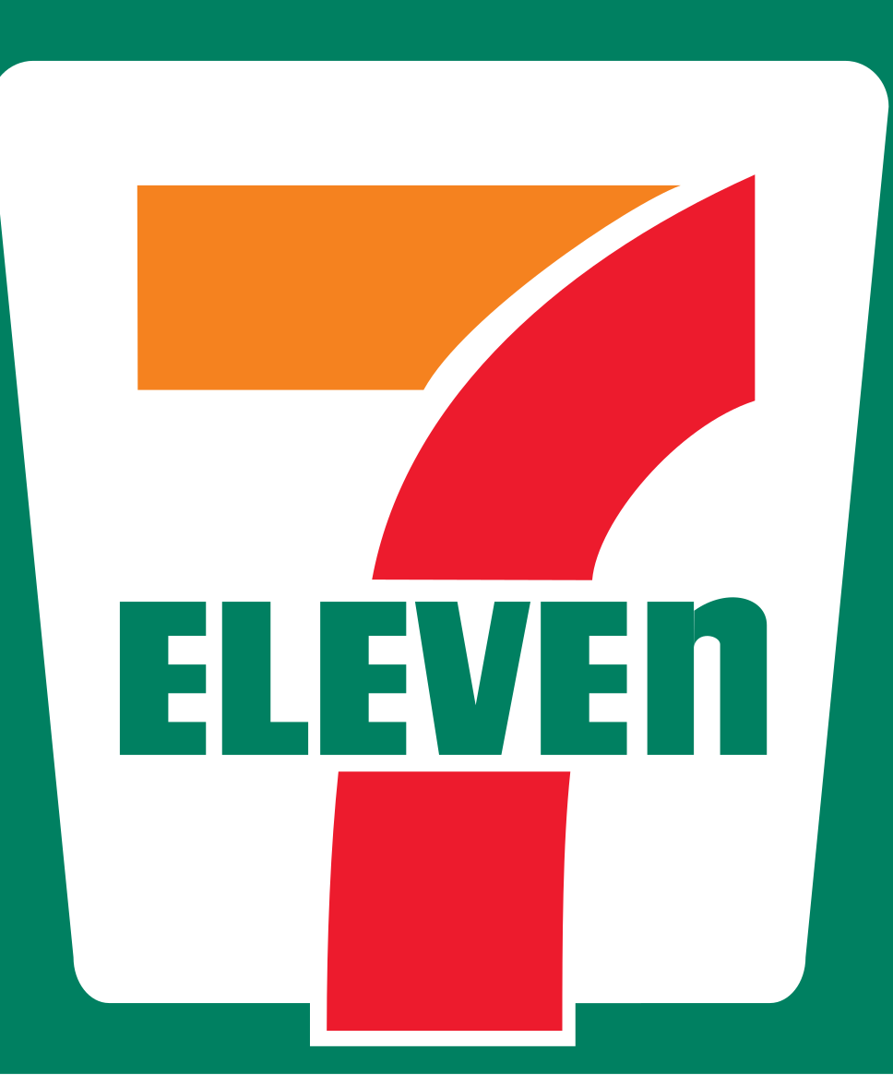





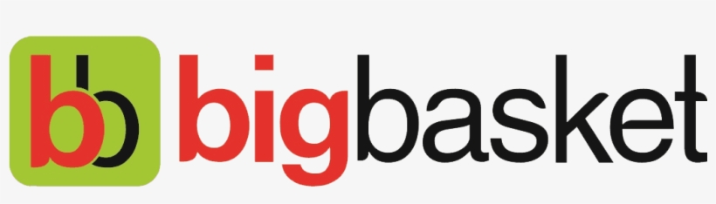

























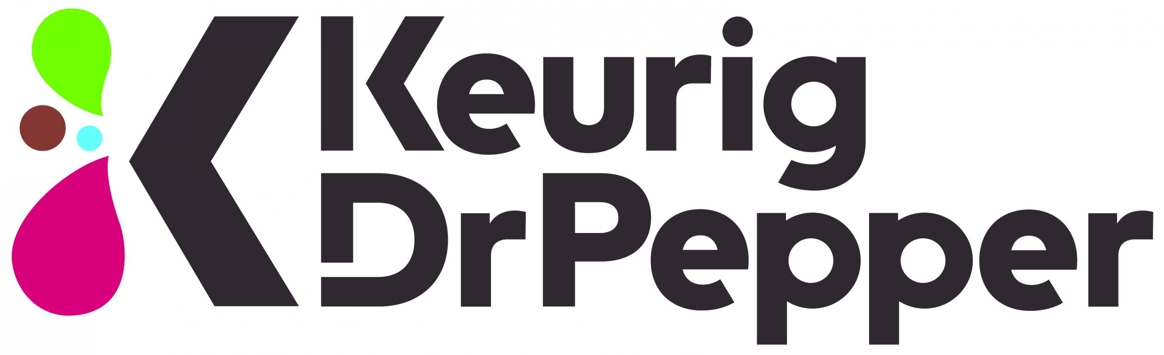

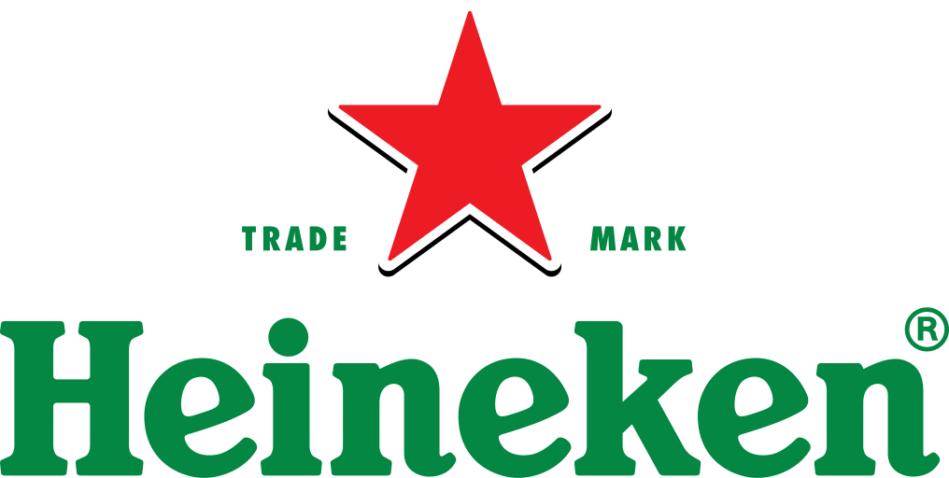



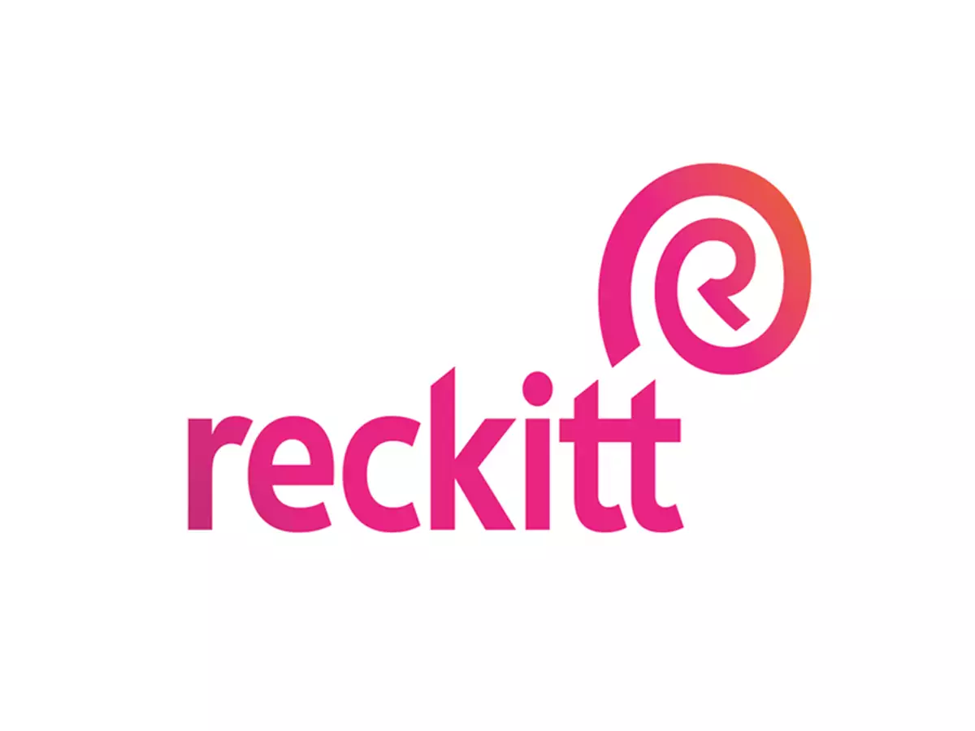









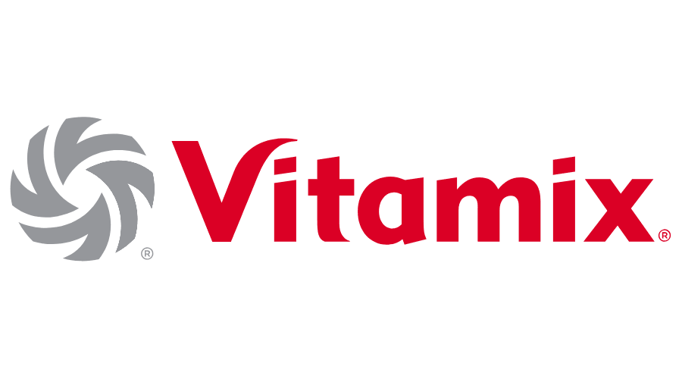


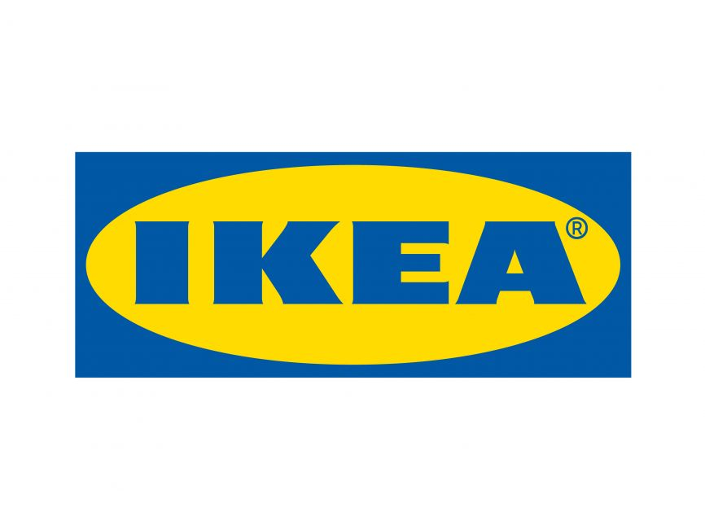








LTIMindtree is trusted partner of Industry leaders for their transformation journey
Mass Merchant, Discount Convenience
Specialty
Apparel & Fashion
Distribution
Focused Retail industry sub-segments
Food, Beverages & Agriculture
Home & Personal Care
Apparel & Footwear
Furniture & Household Appliances
Others (Agriculture, Paints etc.)
Focused CPG industry sub-segments

Slide 10


LTIMindtree is trusted partner of Industry leaders for their transformation journey
Mass Merchant, Discount Convenience
American multinational ecommerce & supermarket giant
Multinational chain with 60,000+ convenience stores globally
Leading discount retailer chain in US
An American multinational retail corporation
leading operator of membership warehouse clubs
India’s largest online food and grocery retailer
An American food distributor and grocery store retailer
Specialty
British multinational electrical and telecom retailer
Home improvement retailer with >2,000 stores
North American office supply retailing corporation
Leading retail gaming and trade-in company
US-based Tele-dentistry company
UK’s leading electronics goods manufacturer
Multinational conglomerate that designs & sells furniture
Apparel & Fashion
Leading sportswear and workout clothes retailer and manufacturer
Luxury fashion retailer
American leading footwear chain
An American manufacturer and online retailer of licensed sportswear
American women's clothing retail chain
An American sportswear and footwear retailer
American apparel company owning multiple brands
Distribution
One of the largest industrial distributors in North America
Leading global supplier of electronic components
US’s leading industrial equipment distributors
Largest suppliers of power tools & specialty materials to professional concrete contractors
US’s the fastest-growing network of independent roofing & building supply distributors
Distributor of plumbing, heating and cooling equipment
A national distributor for grocery stores, supermarkets, and online vendors
Focused Retail industry sub-segments
World Leading British CPG Goods Company
American multinational food manufacturing company
American processed food & snack company
Food, Beverages & Agriculture
Multinational confectionery, food and beverage company
American beverage & coffeemaker conglomerate
World's Largest Food & Beverages Manufacturer
Dutch multinational brewing company
Home & Personal Care
American manufacturer, marketer & distributor of consumer & commercial products
World leader Beauty and Cosmetic Product Manufacturer
Anglo-Dutch multinational consumer goods company
American multinational personal care products company
American multinational personal care corporation
World’s 2nd largest multinational consumer goods corporation
American multinational cosmetics company
Apparel & Footwear
Global sports goods and sportswear manufacturer
American apparel company owning multiple brands
An American sportswear and footwear retailer
British international shoe manufacturer and retailer
British international shoe manufacturer and retailer
Furniture & Household Appliances
Premium & Innovative Household Consumer Appliance Manufacturer
American privately owned vacuum cleaner and floor care product
American leader in commercial blending products & kitchen equipment manufacturer
Japanese multinational specializing in optical, imaging, and industrial products
American developer and manufacturer of audio products
American apparel company owning multiple brands
Leading American manufacturer of batteries
Others (Agriculture, Paints etc.)
American global food and Agri based product manufacturer
World's largest multinational tobacco company
Leading global tobacco company based in England
Major food & agri-business company based in Singapore
Dutch Multinational Paint and Chemical Manufacturer
German manufacturer of optical systems & optoelectronics
American manufacturing best known for its plumbing products
Focused CPG industry sub-segments

Slide 11
Data Driven Continuous Delivery
Develop
Operate
Inno vation
GCH
Collaboration
MSP
Build
Optimize

Slide 12
Introducing LTIMindtree AI First Operations framework…
3
Persona Co-pilots
DevOps Insights
Intelligent Orchestration
{ empower DevOps personas }
{ what | when | why | what if }
{ end to end autonomy }
AI Agents
2
{ task automation | agentic workflows }
Knowledge Fabric
1
{ business and IT ontology | knowledge graphs | small language models: technology, industry, enterprise }
Knowledge Sources
ServiceNow
SharePoint
VF Services, LLC Academy
Cloud and Infrastructure Telemetry
CAST | SAP Profiler
ADO

Slide 13
LTIMindtree – People Rebadging Framework
LTIMindtree People Rebadging Framework
DUE DILIGENCE
PRE REBADGING
REBADGING
INTEGRATION
Understand in-scope organization – roles, nos., skill
Finalize People Transition & Communication Plans
Day 1 in LTIMindtree – Meet, Greet & Assimilate
Implement 90-day Integration program
Gather & analyze HR data– ‘as-is’ costs, benefits mapping
Assess people risks & agree on actions
Introduce to LTIMindtree Manager, work teams in GCH
Initiate goal setting based on agreed service SLA’s
Agree on transfer related principles
Sign off on Comp. mapping, prepare/share LTIMindtree offers
Conduct LTIMindtree workflows & people processes training
Offer internal learning opportunities
Gain key people insights, e.g. critical roles, employee forum
Conduct employee/forum consultation meetings
Set up virtual HR helpdesk
Conduct cultural training sessions
Finalize people plan based on ‘to-be’ delivery model
Ensure benefits setup and smooth pay run
Administer temperature check and publish results
Retention planning for key in-scope employees
Conduct expectation setting sessions
Implement the final signed off people plan
Ensure transfer readiness , e.g. payroll data, etc
COMMUNICATION
CHANGE MANAGEMENT
COMPLIANCE TO LOCAL LAW

Slide 14
Operating Model for Digital and Data
Future State Operating model for running projects in agile POD based models
Key Benefits for VF Services, LLC
VF Services, LLC
Flexible & Designed to Scale
Fit to purpose team constructs across various models & a dedicated bench
Program Office
Client Partners
Engagement Directors
IT Compliance & Support
Governance
Demand/ Supply
Value Realisation
Strategic Plan Alignment
LTIMindtree
LTIMindtree Delivery Centre Management
Integrated Talent Management
Capacity Planning
Capability Building
Billing and Finance
Compliance
and Audit
Business Value Tracking Reporting
Risk Management
Proven Governance
From operations to delivery excellence for management at scale across multiple disciplines
IT Infrastructure
Project Execution Models (One or More models at any given point of time)
Talent Acquisition
Resource based Model
POD based Model
Scope based model
Information Security
Roles from VF Services LLC
+
Role from LTIM
Roles from VF Services, LLC
+
LTIM Technical PODs
LTIM full PODs
Strong CoE leverage
Industry domain experts with strong experience in Digital & Data capabilities
Compliance
and Audit
Culture and Competence Building Team
Flex team (10% Bench)
Quality Function
Talent Development
Collaborative Governance
Dedicated Talent Engine
To ensure the right skills at the right time
Center of Excellence & Academy (Digital and Data)
Frameworks and Accelerators
Agile Delivery
Quality Engineering
Enterprise Integration
BI/ Analytics
Consulting
Legend
VF Services, LLC
LTIM
LTIM Support functions

Slide 15







Building a culture of lifelong learning
‘ITπE’ Model for Learning
Learning triggers
Individualized Learning paths to ensure multi-skilling with depth and breadth
Consultant career growth path
Cross skilling opportunities
Depth in 1 area
Depth in 1 area,
breadth in 2 or more
Depth in 2 areas, breadth in many
Depth & breadth
in many areas
Partner learning Ecosystem
LTIMindtree CoE
VF Services, LLC knowledge
VF Services, LLC Technology and transformation roadmap
SAP learning Hub access to all LTIMindtree SAP associates for SAP certifications
Microsoft content network
Compliance partner trainings
Prototypes, proof of concept, accelerators
Business process procedures and quick reference guides
Upgrading Skills in the CoE center with Job training with Case studies
Induction , onboarding, VF Services, LLC specific mandatory trainings
Continuous knowledge management
Technology roadmap for next one year
Compliance and process audits
SAP and other partner product roadmap
Client Induction
Client Onboarding
Soft Skill
Process
Mandatory Trainings
  Application Understanding
  Various Domain understanding
  Client resource onboarding formalities and processes in Client environment
  Communication
  Project Management
  Presentation, Interpersonal skills
  Consulting, Thought Leadership
  ITIL
  Industrialized Approach
  Agile Methodology
  Template based Communication/Interaction
  System Architecture
  Global Support
  Communication Plan
  SLAs, KPIs
Existing Pool
& New Recruits

Slide 16
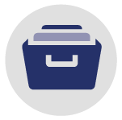






Knowledge management for quick on-boarding of team members
Knowledge Repository
KCD Templates
Business Process Documents
Client’s Induction Material
Certification Process
1
Skills Assessment based on Client’s requirements
3
5
VF Services, LLC Induction Manual Study for end-to-end overview of Application Support (Technology, Tools, Processes)
Internal Certification Process to evaluate performance and ensure complete Knowledge acquisition
Resource Onboarding plan approved by Resource Manager
Knowledge Transition and Mentoring to ensure clear understanding of processes
Resource ready for support
2
4
6
Identification | Competency Mapping | Evaluation | Continuous Improvement

Slide 17
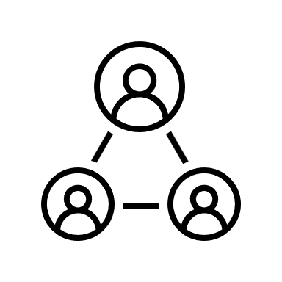










Resource retention framework
Project attrition management
Process/Governance
Talent Retention Approach
Current resource challenges
Loosing critical talent with special skill sets
Lack of appreciation
Lack of opportunities to learn new skills
Identify and promote outperforming resources
LTIMindtree internal
Appraisal reviews
(HR, compensation, )
CCI Resource
Feedback Coordinator
Consistent work life balance by forcing clocked vacations
LTIMindtree Solutions
Provide an active hearing ear to resource concerns
Allow a non-biased bi-directional feedback discussion between the supervisor and resource
Bridge the resource needs/ aspirations to meet customer objectives
Create challenging opportunities
Provide continuous learning/certification platform – LTIMindtree Shoshin School and external SAP certification opportunities
Aspirational
Feedback
Identify, recognize and empower high preforming resources (opportunities and certification)
LTIMindtree Resources
Counselor
Performance
Feedback
Indirect aspiration feedback
Drive high productivity by rotating resources between offshore and Onsite
Vertical Lead
CCI SME
Direct reporting
Rotate resource between onsite and offshore rich customer inclusion
Tower team
LTIMindtree
CCI

Slide 18
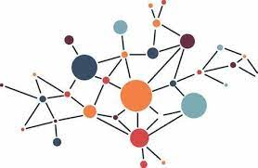
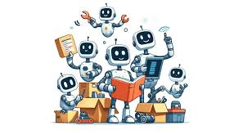

Building Blocks of LTIMindtree AI-Native Solution
1. Knowledge Fabric
2. AI Agents
3. Co-Pilots
>_
Creating a Knowledge Fabric
{ business and IT ontology | knowledge graphs | Large and small language models}
Powering “autonomy” through a collection of agents, built for all workload categories
{ task automation | agentic workflows }
Co-pilots for all personas in the target delivery model
Improve
Resiliency
Improve Business & IT User Experience
Improve Speed
to Market
Reduce
Cost

Slide 19
Introducing LTIMindtree’s AI First Operations framework – AI Native DevOps
3
Persona Co-pilots
DevOps Insights
Intelligent Orchestration
{ empower DevOps personas }
{ what | when | why | what if }
{ end to end autonomy }
AI Agents
2
{ task automation | agentic workflows }
Knowledge Fabric
1
{ business and IT ontology | knowledge graphs | small language models: technology, industry, enterprise }
Knowledge Sources
ITSM
ERP | CRM…
Project management lsls
Document repository
Development/ Testing tools

Slide 20








Our AI based solutions Success Stories
Fortune 100 Bank
Wealth Management
SaaS Provider
Private Pet Hospital
American Asset
Management Company
125+ applications, 140 Databases, 125 Web servers ,1000+ Bots over 7 years generating
Proprietary transfer agency platform in scope | 3000+ test cases | IBM RTC | High regression run of 35+ hours
Canvas AIOPs platform to enable single window operations integrated people process & systems, generated trends and GenAI powered insights to identify RCA, suggest solutions
40+ complex projects, Application lifecycle management with JIRA & TFS
25% MTTR reduction | Shift of incident (L2 to L1) Engineering Technology Group) | automation in Security Services, Trade &Treasury, Consumer Banking, Fiduciary, Markets, Compliance, Finance & Risk | ~20% ops cost reduction
Code to test case correlation with Canvas Knowledge | 45-70% Regression optimization | sprint velocity improvement resulting in 15% cost reduction in Engineering
~8.6 hours per day effort savings achieved due to reduced effort in RCA and resolution of incidents | Digitized & retain knowledge, Ease of access to Knowledge base | Overall 20% cost reduction for Service Desk, L1 ops
Knowledge Fabric powered correlation & clustering of SDLC digital assets | Analyzed 100,000+ defects | NLP-based 25% faster defect triaging | 10% effort reduction​ | 10% cost reduction in engineering
Leading Multinational Professional Service provider
Large Construction Company
Integrated B2B Marketplace
Multinational Energy
Corporation company
125+ applications, 140 Databases, 125 Web servers ,1000+ Bots over 7 years generating
Mailbox Management, O365, MSSQL Server, Linux environment, Ad hoc SAP HANA Server
Canvas AIOPS Orchestrator(
4Complex Modular Architecture | High Regression Run time of 10+ hours
Digitize & Centralize knowledge, enable intelligent automation for repetitive operational tasks
Identified cost reduction opportunities, ~500+ processes identified for Automation, Roadmap created to reach to AIOPs highest maturity, 60% MTTR reduction | 25% potential in Ops Cost reduction
~76% Cycle Time Reduction/month | 12+ Use cases live | 84% effort reduction in DL automation Management | 25% Cost reduction in Service Desk, L1 support
Code to test case correlation with Canvas Knowledge || 60% Regression optimization achieved | sprint velocity improvement | 20% cost reduction in engineering
~40,000 hours of effort saved in 24 months through intelligent workflow automation along with 6k hours of total capacity increase.
58% MTTR reduction for incidents and service requests with zero unplanned downtimes in last 24 months.

Slide 21
Getting to the
future, faster.
Together.

