Slide 1


Murex Capability
Jun 2025

Slide 2










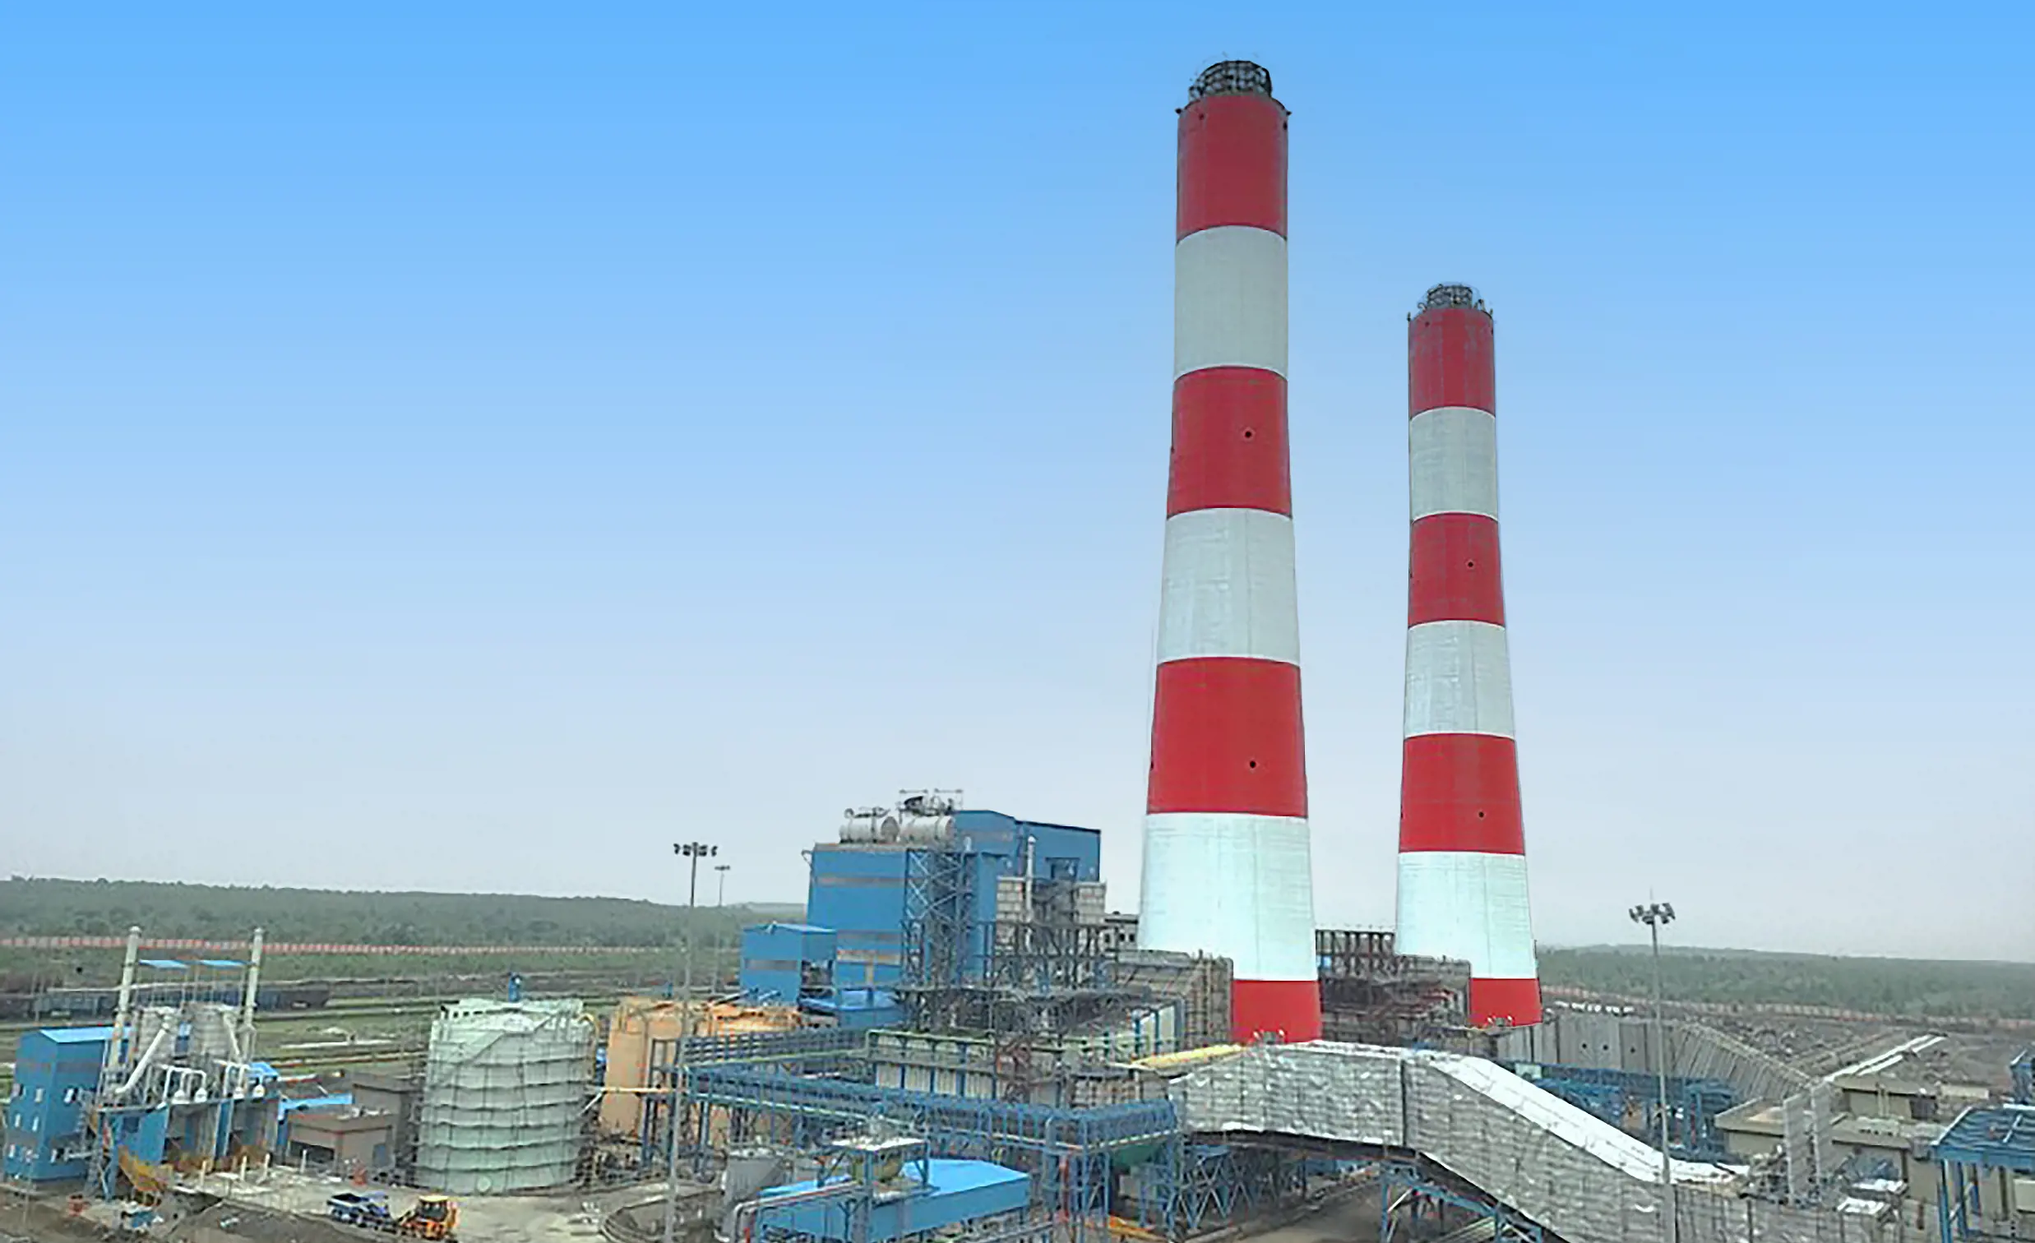
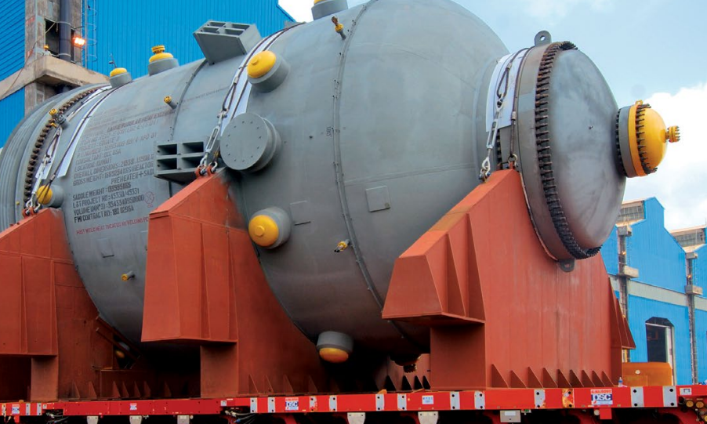



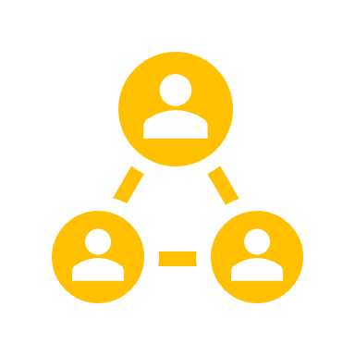


L&T Group Overview
$27.9B
Lines of Business​
REVENUE
Buildings & Factories​
Transportation Infra ​
Heavy Civil infra ​
Water & Effluent Treatment
Metall. & Mat. Handling​
Power T&D
Rural Lending​
Housing Finance​
Wholesale Finance​
Asset Management.
Defense​
Aerospace​
Shipbuilding​.
Roads / Trans. Line ​
Metros​
Power Generation​
02
Defense Engineering
04
Financial Services​
06
Developmental Projects​
08
Infrastructure​
GLOBAL RELATIONSHIP
350,000+
HEADCOUNT
01
03
05
07
09
IT &
Technology Services​
Hydrocarbon
Power
Heavy Engineering
Others​
ENGINEERING DNA
80+
LTIMindtree​
L&T Technology Services ​
Onshore
Offshore
Realty​
Industrial Products & Machinery​
Smart World & Comm​
Process Plant Equipment
Nuclear Power Plant Equipment
Piping Centre & Forgings ​
EPC- Coal & Gas​
Thermal Power Plant​
Construction​
Electrostatic​
Precipitator​
Power Equipment​
Manufacturing​
YEARS OF EXPERIENCE
Global
presence
Mission critical projects ​
People
Centric
Environment & Sustainability Focus Centric

Slide 3

















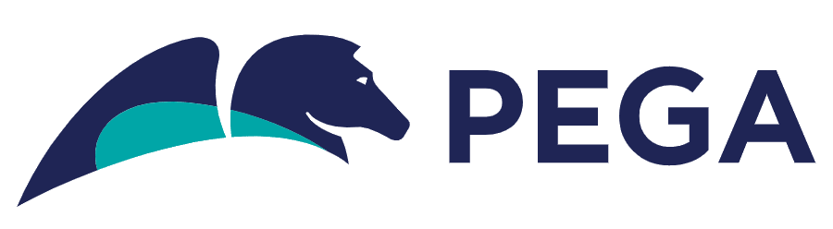


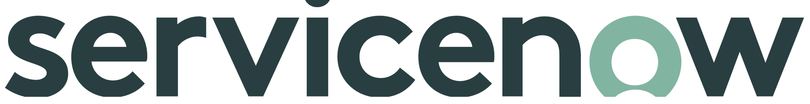


LTIMindtree – 5th Largest India-based Global Tech Consulting & Digital Solutions Firm
84,000+
$ 4.4+
150+
700+
54
30+
Highlights
Employees
Billion
Logos
Active
Patents
Countries
Our tribe of avid problem solver
Annual Revenue
Fortune 500
Client Base
20 Granted
Global Presence
Varied service offerings across the key Business Verticals
Banking, Financial Services & Insurance
Technology, Media & Communications
Manufacturing & Resources
Consumer Business
Healthcare, Life Sciences & Public Services
Data & Analytics
Customer Interactive
Digital Engineering
Cloud, Infra
& Security
Process Automation
Enterprise Svc
& Quality Engg.
AI Engineering
Data Science
Insights as a Service
Business Intelligence
Next Gen Data Management
Data Strategy & Architecture
Cloud Modernization
Design Thinking & Experience Design
Service design and outcome mapping
Rich Applications Development
A/B testing
Marketing Services
Customer journey analytics and insights
Agile Consulting & Dev
Architecture As A Service
Product Engineering
Multi-channel Experience Engineering
Mobile, Browser, API engineering
DevSecOps & SRE
GenAI Engg. capabilities
Cloud Engineering Dev
Multi-cloud management of applications, data, infrastructure
Cybersecurity - Identity
& Access
Cyber Threat Vulnerability
GRC
Cloud Security
Automation Strategy
& Roadmap
Automation Maturity Assessment
Platform Management
Automation, Cloud, Data, Product Engineering., Performance Engineering
Application Modernization
App Production Support
ERP Implementation, Modernization
Experience Assurance
Oracle ERP & EPM led Finance Transformation
Testing Advisory, managed service, test lab
Our Strategic Partner Ecosystem
IPs / Platforms / Accelerators
REDaxis
Genie

Slide 4
LTIMindtree Global Presence
Europe
27 offices
4 Delivery centers
Key Global LTIMindtree Offices
Experience studio
2600+ Associates
Canada
Norway
Finland
UK
Sweden
London
Netherlands
Denmark
Calgary
Ireland
Belgium
Germany
Poland
Bellevue
Toronto
Luxembourg
Czech Republic
Redmond
USA
Saint Louis Parks
Hartford
Switzerland
Hungary
Romania
Warren, NJ
Spain
France
Italy
South Korea
Cincinnati
Edison, NJ
Seoul
Scottsdale
Houston
Cyprus
Japan
Glendale
Alpharetta
China
Shanghai
Tokyo
APAC
14 offices
3 Delivery centers
Dallas, TX
Gainesville
Morocco
Saudi Arabia
India
North America
17 offices
14 Delivery centers
Tampa
Casablanca
Qatar
Delhi
Taiwan
Mexico
UAE
Kolkata
Taipei
Miguel Hidalgo
Riyadh
Dubai
Mumbai
Thailand
Cuauhtémoc
Costa Rica
Pune
Hyderabad
Philippines
San Jose
Bengaluru
Malaysia
Makati City
500+ Associates
7,700+ Associates
Chennai
Kuala Lumpur
Singapore
Johannesburg
Australia
Central America
4 office
2 Delivery center
Durban
Middle East & South Africa
11 offices
3 Delivery center
India
39 offices
34 Delivery centers
Sydney
South Africa
Melbourne
250+ Associates
850+ Associates
72,500+ Associates
Delivery centers North America | Europe | Central America | Middle East & S Africa | India | APAC

Slide 5








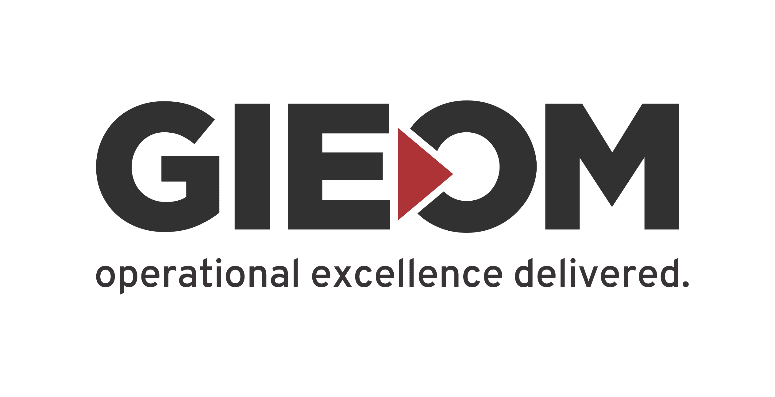
















Financial Services @ LTIMindtree
Snapshot demonstrating the scale of our experience across Banking and Financial Services
31,000+
Active BFSI Practitioners
(82K Overall)
1.6 Bn+
Annual BFSI Revenue
Largest Business Unit
5 OF TOP 10
GSIB banks
(220+ Total Clientele)
4 OF TOP 10
Wealth
Service Providers
20%
5 year CAGR
Industry Leading Growth
Unitrax®
Support 60% Canadian
Asset Managers
We deliver Value and Differentiated Outcomes across the entire spectrum from Core to Experience
Digital Services
App Management Services
Cloud & Infra Services
COTS Product Expertise
Data Offerings
Enterprise Solutions
Banking & Insurance
API & Microservices
Mobility
Data & Analytics
Internet of Things
AI & Cognitive
Intelligent RPA
Digital Integration
Service & Business Desk
App L1/L2/L3 Support
MW & STE Support
SRE, DevOps Engineering
DBA & Command Centre
CISO & Infra Support
Testing Advisory, managed service, test lab
Enterprise IT Infra
Digital Workplace
Cloud IaaS
Cross Functional Services
ServiceNow
Calypso
Sunguard Front Arena
Murex
Bloomberg
Charles River
Smart Stream TLM
Multifonds / Temenos
Duckcreek, Guidewire
Data Governance
Data Lineage
Data Lake & Catalogue
Data Quality
Meta Data Management
Data Privacy
Salesforce
Snowflake
AWS
Oracle
Microsoft Dynamics 365
IBM
Pega
Capital Markets
Market Infrastructure
Regulatory Compliance
Through a suite of well-crafted bespoke solutions customized or built to address banking specific challenges
IPS AND ACCELERATORS
PRODUCT / TECH / FINTECH ALLIANCES & PARTNERSHIPS
PLATFORMS

Slide 6




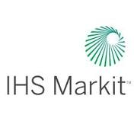







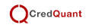




Capital Markets Overview
What we bring to the table
Application Dev, Support and Infrastructure
Specialized Services
  15+ Solutions & Accelerators including
Strategic partner across Application development & support, QA, and Infrastructure driving modernization and transformation
  Core Platform Modernization
  Product Implementation & Data Migration
  Investor Journey Transformation
  Advisor Experience Transformation
  Regulatory Reporting, Financial Crime and AML
  ESG Risk and Reporting
  Business Operations
  Advisory & domain consulting, e.g., Build vs Buy, Business Case development
  Wealth Management as a Service (Wealth 360) - WealthDecisions®, Wealthlink, Wealthdocs, dCCM
  ESG & Portfolio Analytics powered by Lumin
  Fosfor for AWM, ESG Reporting, Risk Modeling
  Quantum AI powered Portfolio Optimization, Fraud detection
  Metaverse concept for wealth mgmt. use cases
6K+
FTEs
Global asset manager with AuM of $400 bn
Successful remote transition. DevSecOps for IT lifecycle automation for 125+ applications. LTIM platform (mWatch) for Infrastructure monitoring. Metrics based fin reporting and agile based delivery
80% increase in Test Automation coverage;
6K hours of effort savings YoY for infra
First call resolution improvement from 52% to 70%
What makes us unique
Strong expertise in the next-gen capital markets platforms
Capital Markets & Asset Management specific strong innovation and partner ecosystem
Building market-leading IPs and Platforms for insights and extract the most from data-to-decisions value chain
Platform Development
Building the Next-gen Multi-tenant Wealth Management Platform for Leading FinTech firm
A global Fintech leader
Platform modernization, build platforms & portals, automation, DevOps & agile frameworks
Developed QA Automation strategy for DevOps CI pipeline & In-sprint Automation
Industry Recognitions
Recognized as ‘Major Contender’ and ‘Star Performer’ for Banking and Capital Markets in 2022
Ranked #1 in Formidable Challengers for Capital Markets 2022

Slide 7
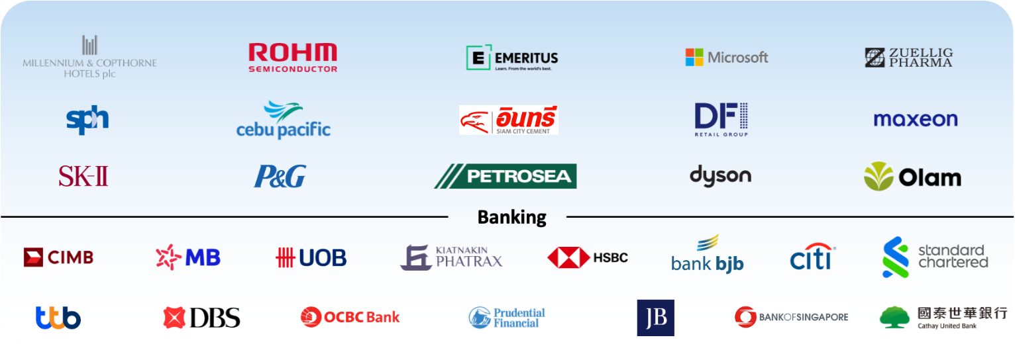
We have a strong presence in ASEAN region too
3500+
FTE’s working for
ASEAN projects
250+
FTE presence in
ASEAN Region
45+
Clients
LTIM Clientele
Notes:
CitiBank…largest customer…Jin hew , we spoke on this
UOB have been our customer since 2010…
Banj Julius baer…since 2017

Slide 8
Murex Capability & Success Stories

Slide 9

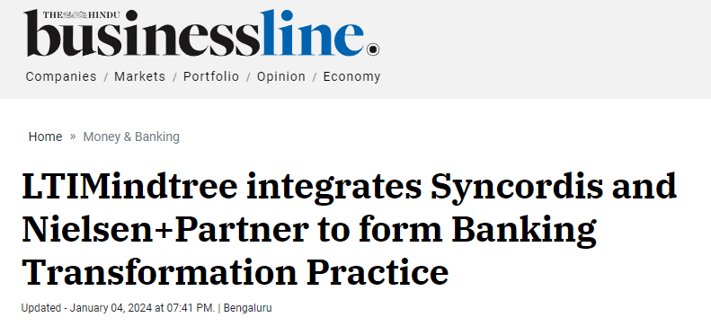












We have setup a dedicated Banking Transformation Practice focusing on leading
Fintech/ digital banking platforms
The BTP to deliver end-to-end consulting, digital and IT services, leveraging commercial off-the-shelf (COTS) products and platforms serving banks and capital market firms
Long term partnership with clients, moving from Implementation to Managed Services
400+
SMEs experts
1000+
Product Specialists
Best of the breed partnerships
Notes:
In the recent past..
Our MSA also have been novated from Syncordis to LTIMindtree..
Under BTP…we brought all the Banking products under BTP…
Temenos and Oracle we were strong from LTI side…Murex…Mindtree was the partner for Murex…there’s no single bank in the region where we have not done Murex work through

Slide 10
Our Murex Credentials
20+
Years of product knowledge
700+
Person-years of Murex experience
125+
Projects Implemented
30+
Global
Clients
First SI partner to setup Murex Reference environment on Cloud
Key Offerings
Value Proposition
Managed services Support &
Maintenance
Version
Upgrades
Greenfield Implementation
System Integration
Product Engineering
Consulting
Testing
Murex partner from 2007
360 partnership with Murex
Large managed services engagements with leading APAC banks
First SI partner to migrate Murex to Azure
Solution accelerator for digital interface to Murex
Notable Projects
Version Upgrades – Mx 2.11 to Mx 3.1 for leading investment banks in Singapore
15 Years of Murex Production Support – BAU for a leading bank in Japan
Part of the Murex team in Product engineering
Interfaces – Upstream/ Downstream development for a leading Australian bank
FO, BO and MO Support for leading EU banks
Murex 3.1 upgrade for a leading bank in US
Accelerators
Digital front end for Murex
Test Automation Framework
Rapid Data Comparator – Accelerating migration
Azure migration framework for Murex

Slide 11
Our Murex Service Offerings
Implementation
Upgrade Service
Enhancements
Testing
BAU - Run the Bank
Murex on Cloud
  Legacy to Murex migration
  Product Configuration – FO, MO, BO
  Workflows, Interfaces
  Reports, Risk
  Marketdata
  Murex Migrations
  Version upgrade
  Database Migration
  Integration upgrade
  OS/Hardware Upgrade
  Integration to Up/Downstream
  Webservices API
  Configuration across modules
  Functional,
  Manual
  Regression Testing
  Test Automation & Framework
  SIT & UAT
  Level 1 /2/3 support
  Environment support
  EOD Monitoring
  Infrastructure Support
  OS/Murex Upgrade
  Consulting and POC
  Implementation
  Migration
  Managed Services
Front Office
System Configuration
Pricing
Model Integration
Simulation
eTradepad
PL VAR, PL/Risk Analysis
Mid/Back Office
RTI and MDCS
Deal Capture
Market Parameters
Trade Workflows
Pre-Trade Rules
Reporting
Static Data, System Configuration
MLC
VaR
Risk Matrices
P & L Analysis
Collateral
Technical
Payments
Confirmations
SWIFT
Accounting
Reporting
STP/Trade Workflow
MxML Workflow
C2 Interfaces
Datamart & Reporting
EOD Configuration
Environment Management
Test Automation
Processing Scripts
Load Balancing
Housekeeping
Process Automation
Health Check
CTT

Slide 12








Clients and projects
World Bank Group, US
State Street, US
Jeffries, US
Mizuho Bank, US
Murex Greenfield Implementation
GOM setup for Capital Markets Division
Front Office Configuration and Integration, Supported in Testing and validation of the configuration
Built datamart extractions and reports supporting various desks and divisions
Murex Upgrade (UaaS)
Support the upgrade in line with Murex delivery model
  FRTB Implementation
Supported in evaluating the FRTB requirements
Executed in line with Murex CI/CD process, in agile mode
Front Office Configuration
Automation of the respective test cases and Integration testing with MXTEST
Build related simulation reports and extractions
Murex Version Upgrade
Supported the upgrade in line with UaaS methodology – Mx 3.1.36 to 46
Did the changes needed for upgrade in Back Office Operation and Processing
Built the regression test package(RTP) in MXTEST, for upgrade
Supported the various test cycles of the upgrade
Done the validation with MXTEST
Integration Project
Built workflows integrating with upstream and downstream systems
Supported in Back Office workflows integration
Built the regression test pack in MXTEST
Validation of the workflows in MXTEST
Northern Trust, US
Nationwide, UK
RBC, Canada
Standard Bank, SA
Support, Maintenance & enhancement
Built Interfaces with MxML and reports
Integration of high volume trade imports using Trade Data Synchronization( TDS) tool
Configured the Market data Import with MDIT
Validation of workflows and reports
  Murex reporting in greenfield implementation
  72 Complex Reports are being designed, built and tested in just 3 Months
  Murex implementation was back on track and went live on time
  Murex Development, Testing and Support
  Offshore partner for the Murex projects
  Enhancements in Front Office, Workflows, MarketData, Back Office, Reporting,
  Environment support
  Testing with MXTEST
  Purging and reporting
  Actuate Report development in Mx3.1
  Creation and execution of datamart extractions, datamart viewers and batches.
  Logical and physical purging of deals from planning, execution and validation
Notes:
International Financial Institution – Worldbank
One of the largest custodian bank – StateStreet
Leading American Investment Bank – Jefferies
Leading Investment bank – Mizuho Bank
One of the largest and old banking institution – Northern Trust
State owned financial institution in Canada – ATB
One of the largest commercial bank – NCB
Leading Institutional Investor - CDPQ

Slide 13








Clients and projects
DBS, Singapore
OCBC, Singapore
Standard Chartered Bank, Singapore
Siam Commercial Bank, Thailand
Murex upgrade, Support, Maintenance
& enhancement
MX 2.1 to MX 3.1 upgrade covering end to end trade lifecycle with support for new products and pricing methodologies
4,000+ Reports migrated from 5 different sub systems
Quality Assurance, Enhancements
Established end to end test planning and execution process for Trade Execution System
Managed the enhancement requests from requirement analysis, design , build, validation and deployment support & hyper care, for workflows and reports.
Integration, Reporting
Managed the integration with upstream and downstream systems, involving in design and build of workflows, reports
Supported in the configuration from FO, MO and BO, covering the trade life cycle.
  Murex Testing, Environment/ Configuration Management
Defined test strategy for Murex testing, managing the testing with full coverage
Led the defect triage meeting to close the defects, managing multiple stakeholders
Managed the configuration in each environment as per the releases and testing sign off
ANZ, Australia
CNCBI, Hong Kong
Shinsei Bank, Tokyo
NAB, Australia
Murex Upgrade
Upgrade the Murex instance, in align with Murex delivery
BO functionalities implementation and testing.
Run the regression test covering all the modules and functions
  Distribution Platform
Enhanced trading experience with better visuals and easy-to-use application​
API-based interfacing with trading applications to ensure flexibility to support multiple financial products, starting with Forex and later on for Structured products​
Murex migration, implementation, Support
Mx 3.1 migration, FX asset class migration from Calypso to Murex
Provided cost effective managed services support in onsite – offshore model
Providing production support with 100% SLA adherence for 11 years
  Datamart re engineering
Did the complete reengineering of the reporting architecture In Mx3.
Removed the usage of non native Murex objects.
Implemented the optimized architecture, which help to make the EOD SLA.
Notes:
Singapore based Investment Bank - DBS
Hong Kong based Investment Bank - CNCBI
Tokyo based Investment Bank – Shinsei Bank
Singapore based Investment Bank – OCBC
Leading Malaysian Bank – CIMB
Major South African Bank – Standard Bank
Leading financial institution in Australia – NAB
Leading UK financial institution – Nationwide Building Society

Slide 14
Getting to the
future, faster.
Together.

