Slide 1


Delivering Transformation in Payments
Jun 2025

Slide 2














LTIMindtree is a part of Larsen & Toubro (L&T) group, a $22B engineering conglomerate
A rich heritage that amplifies LTIMindtree’s capabilities with an Engineering DNA
L&T is a leader in most industry segments that it operates…
Construction
Hydrocarbon
Heavy Engineering
Defense
80 Years of experience
$ 22 Bn Turnover
Power
Transportation
Equipment Mfg.
Minerals & Metals
Engineering DNA
Deep Domain expertise
Financial Services
Information Technology
Edu Tech
Real Estate
..by fostering a culture of excellence and innovation

Slide 3






We are partnering with our clients for getting to the future, faster. Together.
We are a scale disruptor…
$4.3+ Bn
81,000+
$1.6B+
170+
25,000+
20%+
50%+
LTIM Revenue
LTIM Associates
BFSI Revenue
BFSI Clients
BFSI Associates
5yr. CAGR
GSIBs are clients
…supporting clients to operate, transform and innovate from core to experience
Core business functions (back office)
Customer-centric functions (front office)
Core banking platform
(BaaS | Core systems modernization)
GRC
(Reg reporting, compliance, risk management)
Driving value from
Experience Transformation
(Customer & User Experience)
Customer Engagement
(Digital Marketing | Commerce)
Core-to- Experience
Data Driven Transformation
Data | Decisions | Monetization | AI ML Ops | AML Solutions
API & Fintech enablement
(Open banking | Partnerships)
Digital product engineering
(Agile, Dev-Ops & Product-oriented Models)
Leader in Everest Group’s Capital Markets, Payments & Lending IT Services PEAK Matrix® Assessment 2023
Ranked Enterprise Innovators for Core Banking Modernization, 2024
Positioned as Leaders for ESG Services in Banking, 2024
Recognizes as a Leader in Core Modernization & Payment Services in US - 2023
Ranked Innovators for Avasant Banking Digital Services, 2024
Notes:
recognitions

Slide 4




We have incubated specialized practices within BFS focusing on domain, technology & solutions…
Domain
Technology
Partnerships
Platforms / IPs
Digital Banking
Core, Channels, Retail & Corporate Products
Cards & Payments
Core & Digital Payments, Issuing & Acquiring
Capital Markets Platforms, Wealth & Asset Management
Architecture
Modernization, Consulting
Hyperscalers
Microsoft, AWS, GCP
LTIM BaaS
Banking as a Service Platform
Digital
API, Experience, Automation, Digital Marketing, New Tech
Industry Platforms
Temenos, Pega, Fiserv, FIS, Finastra, Newgen, Intellect
Fosfor
Spectra, Refract and Lumin
Data
Data on Cloud, Analytics, AI/ML, GenAI
New Tech
Snowflake, SFDC, ServiceNow, Camunda
Industry Solutions
Financial Wellbeing, Money in Motion, SmartPAY, MT2
Risk & Compliance
KYC, AML, Fraud Monitoring & Regulatory Compliance
Cloud
Enablement, Engg., DevOps
Fintech
10X, Thought Machine, Mambu, M2P, Gieom
Technology Platforms
Canvas, Canvas.AI, Infinity

Slide 5
Our Payments & Cards Practice

Slide 6




































Our Cards & Payments Practice has scaled significant in recent years to support diversified clientele including banks and pay tech leaders
4500+
50+
70+
30%
55%
FTEs
Marquee Clients
Countries Supported
YoY Growth
Digital Services Revenue
GLOBAL BANKS
REGIONAL BANKS
CARD NETWORKS
PAYMENT PROCESSORS
PAYTECHS
REGULATORS
Our Strategy
We have expertise in Global Payments (Retail & Corporate)
AI in Everything | Everything for AI | AI for Everyone
Cards Issuing & Acquiring| Account Based Payments | Switch

Slide 7


Key Challenges we see in Payments industry
Key Areas of Focus for Payments Transformation
Complying with industry standards
Compliance with PCI DSS/PSD2 | Mandatory Scheme Compliance | ISO20022 | Sanctions, AML & Fraud
1.
Run the Day - Payment Standards & Regulatory Compliance
Help banks and PayTechs upgrade their systems to comply with the evolving regulatory demands.
Need for greater Security, Resiliency, Scalability and reduce TCO
Customer experience | Faster time to Market | Operational Efficiency| Cloud Migration | Data security & privacy | Stringent SLAs
2.
Run the Day - Core Modernization
Transformation from Legacy monolithic systems to Cloud Agnostic Microservice based architecture.
3.
Change the Week – Digital Transformation & Real Time Payments
Enhance customer experience with seamless, frictionless, simple and faster payment alternatives.
Rise of new payment methods and adjacencies for growth
BNPL | NFC (contactless) | RTP | Co-branded cards |
Digital wallets | Alternate Payment methods | VOP
4.
Transform the Month – Beyond Payments
New business models/fintech ecosystems & solutions powered by New / Emerging Tech such as blockchain, Quantum, GenAI etc.
Diversification into VAS & Personalization in the evolving digital landscape
Retail analytics | Loyalty | Advisory | Marketing insights

Slide 8






We are enabling adoption of digital tenets powering the future of Payments
Payment Standards & Regulatory Compliance
Payment Consolidation & Modernization
Real Time Payments & Digital Transformation
Elicitation, Impact analysis, exceptional handling for CBPR+, ESMIG T2 & EURO1 migration from MT to ISO20022 via SWIFT’s AMH and FIS OPF
Orchestration of various payment types through a single channel by leveraging the Seeburger BIS tool to replace the legacy mainframe-based application
Phase-wise enablement using VolPay (Volante). Customers to have a seamless experience while initiating the payments irrespective of the scheme be it TCH/RTP or FedNow.
  Consulting partner to support ongoing scheme related mandates and integrate with Fiserv’s EPP product for payment standardization
Moved from “application centric” enterprise architecture to a new lean “data centric” SOA aligned service driven architecture
Bank and Scheme specific enhancements in the ACI-UPF. Developed Service APIs for MasterCard Send, Zelle, TCH RTP schemes along with End-to-end payment product testing regression suite.

Slide 9





















We are enabling the strong foundational capabilities for our clients
Consulting
Platform Selection
BFS Innovation Lab
Business & Technology consulting to establish true north star, roadmap definition and implementation to deliver business value
COTS platform or custom solution recommendation to realize payment capability
Nurturing innovation in collaboration with clients and partners in fail-fast & fail-safe manner
Reimagine business process to deliver business value
Discovery & Vendor Shortlisting
Co-innovation as a Service
Payment ecosystem assessment and remediations recommendations
Vendor Demo & Evaluation using Assessment Framework
Digital Sandbox & Engineering Platform
Target state architecture and roadmap definition
Recommendation & Roadmap
Assets Marketplace
Payment Reference Architecture - Business & IT

Slide 10




















Leveraging our Innovation Ecosystem / BFS Labs for delivering value - Idea to industrialization
BFS Labs
Innovation as a service, digital sandbox and asset marketplace
Fintech Solutions & Ideation Platform
Marketplace based API
centric solutions
BFS Labs & Studio for rapid prototyping and POCs
ESG Analytics, Open Finance, Gamification, New Business Models
Blockchain based Bond issuance and trading platform
Marketplace based API centric solutions
Co-Innovation with Clients
BFS
Innovation Labs
Our worldwide labs & Studio for IP Development
Partnering with Fintechs to improve credit underwriting & microlending
Experience Center for Immersive Technologies - India
Joint Value Propositions & Collaboration with Partners
Internal &
Client
Hackathons
Org wide Hackathon
Runners
Up Position
Emerging Tech – Collaboration with Academia & startups
100K BFS
Innovation Challenge​
Generative AI
Platform based approach to realizing both business and productivity use cases
Quantum Computing
Partnerships with Oxford, IIT, Qunu and D-Wave on Quantum Cryptography
MT² – Message Transformation Tool
Payment Message transformation tool for faster ISO20022 adoption
60+ Broader Solutions
Accelerators / Tools
developed across the
modernization spectrum
Sustainability
ESG Analytics,
Green IT Index,
SCR Insights

Slide 11
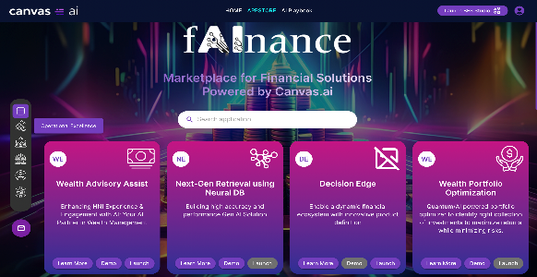



Pivoting on AI/GenAI to deliver value
BFS Practice
Industrializing AI/GenAI for BFS clients
30+ AI/GenAI solutions in our fAInance Marketplace
American Financial Services Firm
Large Super Regional Bank
US Based Global Bank
Global Development Bank
Financial Analyst Copilot for Automating Financial Reports
Intelligent Virtual Assistant for Superior Customer Service
Activities, Risks, Controls, Monitoring Management & Governance
Reimagining Complex Contract Lifecycle with AI Agents
~60%
Operational Cost Reduction
~60%
Increased Productivity
> 1Mn
Controls Rationalized
~40%
Faster TAT
Large Regional Bank
US Based Global Bank
US-Based Global Fintech Leader
Global Banking & Financial Services Major
1200+
GenAI Foundational Platform
Global GSI partner
AI Use Cases For BFS
leader in GPU technology & AI solutions
AI-driven Decision Analytics for Revenue Optimization
Transforming Agent Experience with Conversational AI
Legacy Code Modernization using GenAI
Revolutionizing Campaign Strategy with GenAI
LTIMindtree GenAI offerings listed on
300+
AI Use Cases
90%
Operational Cost Reduction
25%
Effort Reduction
~80%
Faster Content Generation
6 academia partnerships

Slide 12
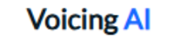

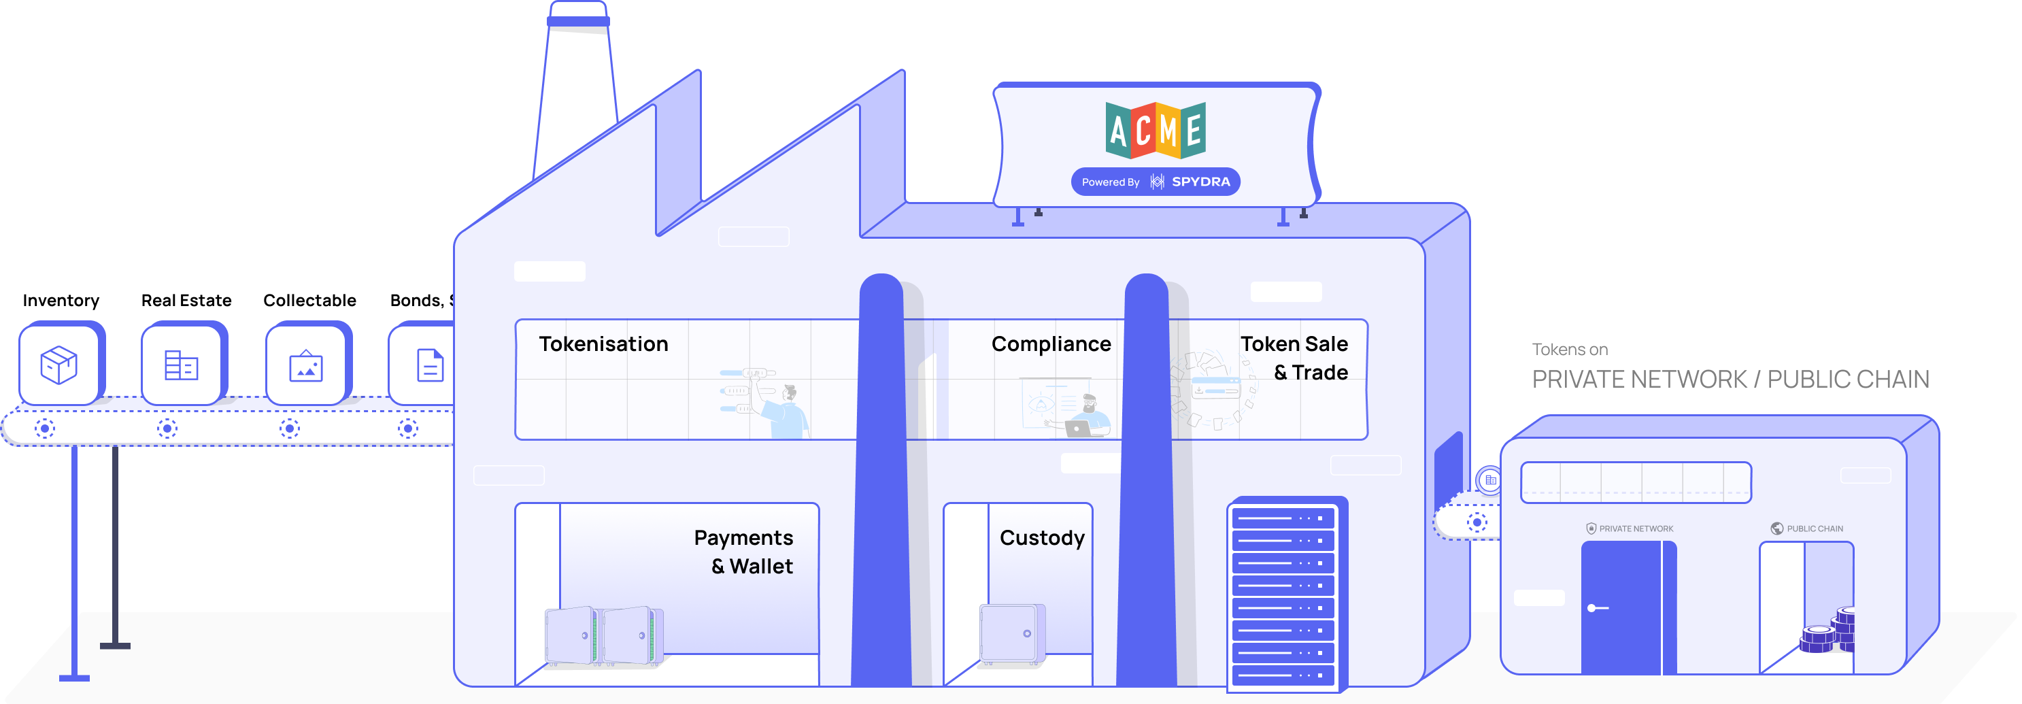
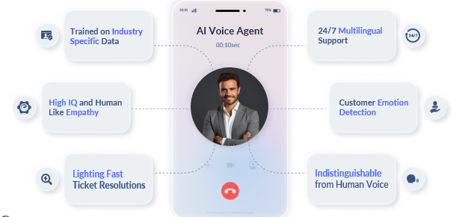
Strategic Investments in New Age Platforms which can deliver value
BFS Practice
Advanced Agentic Voice AI Platform
Low code Blockchain Platform
Products
Blockchain as a Service
Asset Tokenization
Tokenized Deposits
CBDC in a Box
Debt Collection
Loan Applications
Mutual Fund Management
Security-based Fund raising
Digital Proxy
Voting
Real-time Settlements & Reconciliation
Use
Cases
Use
Cases
Credit Card Application
Policy Renewal Upgrqde
HELOC (Home Equity Line of Credit) Guidance
Blockchain-based bilateral Repo
Security Reference Data on Blockchain
Digital Client Onboarding

Slide 13
Getting to the
future, faster.
Together.

Slide 14










Our Expertise in Payments Domain
Capabilities
Payments Processing
Fraud, Risk Mgmt. &
Reporting
Customer Management
Technology & Integration
Services
Domestic Payments
International Payments
Institutional Payments
Card Payments
Real Time Payments
Fraud detection
Risk assessment
Chargeback Management
Compliance Monitoring
Regulatory Compliance
Financial Reporting
Audit & Control
Customer Onboarding
Customer Relationship Management
Customer Self-Service
Customer Feedback
API Integration
Core banking integration
Security & Access Management
Client Self-Service Portal
Core Modernization & Consolidation
RTP enablement
Product Enhancement & Migration
Regulatory Compliance including ISO 20022 adoption
Tokenization
Data & Analytics
Quality Engineering & Scheme Certification
Production Support
Transaction and Business Activity Monitoring
Money in Motion, Hyper-Personalization
Domain & Technology Consulting
Platform Selection
BFS Innovation Lab
Current State Assessment, Define Future State with Roadmap
COTS platform or custom solution recommendation
Building competency for global product /platforms
Industry Leading Platform Expertise
Major Programs for Global Banks and Fintechs
Payments Channel Modernization Partner
ISO20022 Standardization & Migration
Enabling seamless cross-border payments
Payments Experience Transformation
Building Cloud-first Payments Solution
Strong Innovation and Partner Ecosystem
Orchestration of various payment types through a single channel by leveraging the Seeburger BIS tool to replace the legacy mainframe-based application
Elicitation, Impact analysis, exceptional handling for CBPR+, ESMIG T2 & EURO1 migration from MT to ISO20022 via SWIFT’s Alliance messaging hub.
Enable bank to receive cross-border payments with customizations at Core banking (including Flex & V+) and Upstream applications like Sanctions and fraud
Phase-wise enablement using VolPay (Volante). Customers to have a seamless experience while initiating the payments irrespective of the scheme be it TCH/RTP or FedNow.
A fully ISO native payments solution built in the cloud. Involved in product feature development specific to banks, configurations and testing, hence enabling for rapid growth

