Slide 1


Appian Capability

Slide 2








LTIM Overview
LTIMindtree is part of Larsen & Toubro - a $21 billion+ technology & engineering giant.
Our focused expertise to
deliver cutting-edge solutions
Leading digital transformation partner
with a history of over two decades.
We work with the
leading global companies
across our 11 industry verticals.
$4.1B+
$21B+
Annual revenue
Annual revenue of parent company
82,000+
Employees
Over 83 years of experience
750+
Global clients
Engineering DNA
Offices in
30+
100,000+ group employees
Countries

Slide 3


















Low Code & Integration (LCI) Practice
3000+ Consultants
200+
Active Clients
2000+
Certified Consultants
20+
Solutions
Apps Modernization
Process Transformation
Connected Enterprise
ALLIANCE PARTNERS

Slide 4










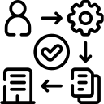

An expert in delivering Appian based solution
Leveraging synergy of stronger low code practice
3000+
120+
30+
15+
Low Code App Experts
Low Code Customers
Appian Engagements
Appian Assets & Enablers
Experienced in different Low Code Tools
Across 30+ Countries
Across geographies & Verticals
Frameworks, Solution prototypes, Sandbox Platform, Best practices
Our Readiness
16
Delivery Locations
300+
Appian Consultants
150+
Processes
Dedicated Appian COE
Strategic Partnership
Ensuring local talent & governance
Delivering End to End Process Automation with 100+ Appian certified
To Automate, Extend or Connect across Enterprise
Helping in Design, Automate and Optimize
Partner driven GTM driving growth.
Our Enablers
How We Support Our Customers
ROI Calculator
Onboarding Co-Pilot
Applify.ai
Risk & Control Governance
AI Starter Kit
Project Business Benefits
Accelerate Onboarding with AI
GenAI based Application Buildouts
Reimagining EUC Remediation
Enabler to accelerate AI Journey

Slide 5
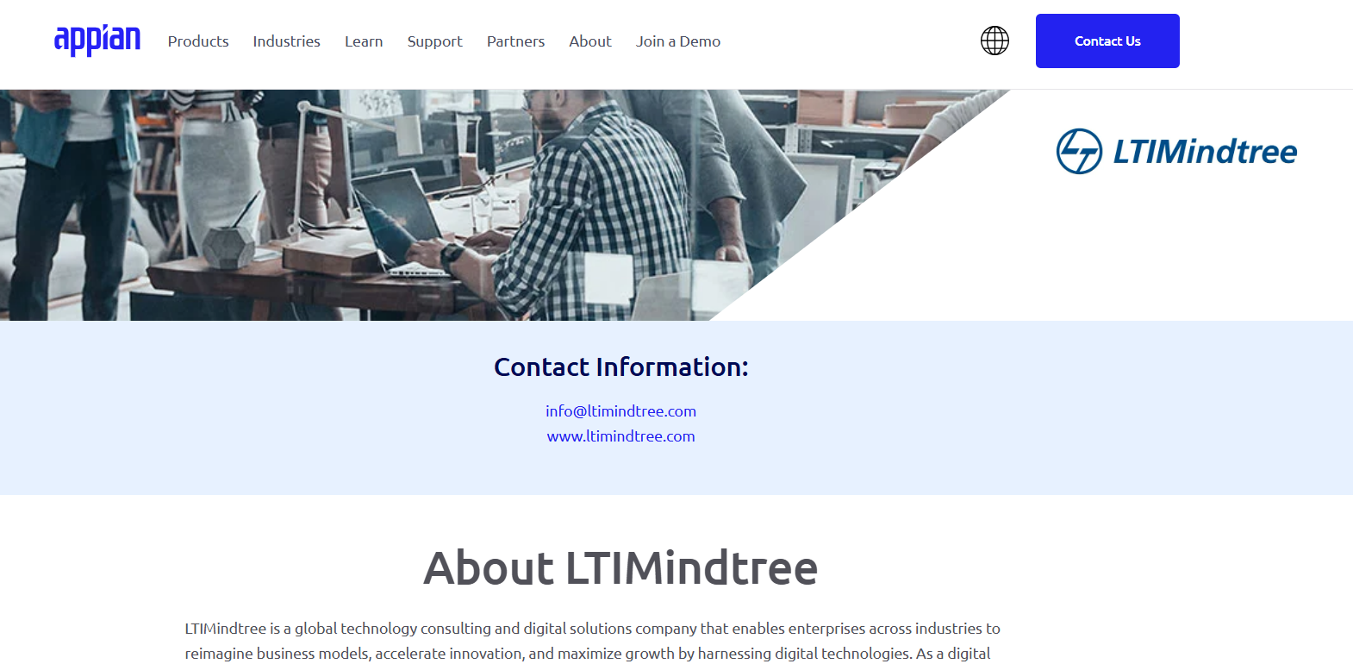
We are the Appian Partner

Slide 6
Our Unique Value Proposition
Exhibit Appian AI Capability
Deliver MVP
Deliver EUC (Excel / VB) Remediation
Operationalize POD
Elevate Enterprise
Accelerate Craft
Compute Revive
Govern360
Accelerate AI Journey of an Enterprise in Weeks rather than Months
Deliver values to business within 3 Months
Remediate your EUC in 40% faster
Establish Appian Delivery POD in 2 Months, COE POD In 4 Months
Leveraging our AI ToolKit & Appian Lab
Using structured Design Workshops & Applify.AI
Using EUC Remediation Approach and Complete Care Services
Using COE Governance framework, structured recruitment and enablement framework
How We can Help
Solution-ize your idea with our expert pool of resources
Early adoption of new feature of Appian by leveraging Appian partnership
Flexible engagement model for simplifying operational process
Agile Service delivery approach to accommodate early feedbacks
Global Delivery Model for 24x7 of Services backed by Best Practices and Process Assets
Defined Enablement framework to scale
Dedicated Recruitment Team to recruit new expert talent
Ensure Quality governance leveraging dedicated Quality Team

Slide 7


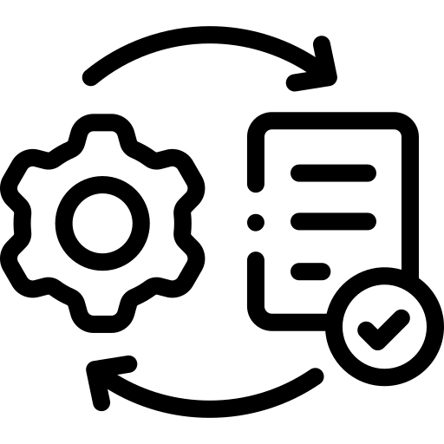

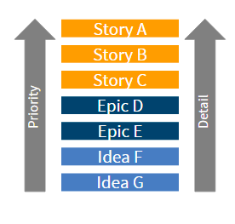

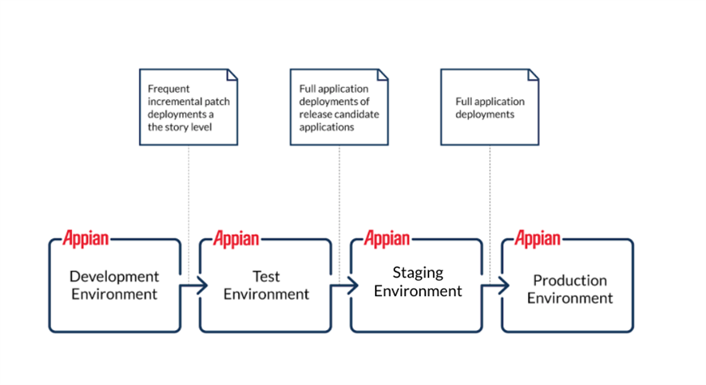


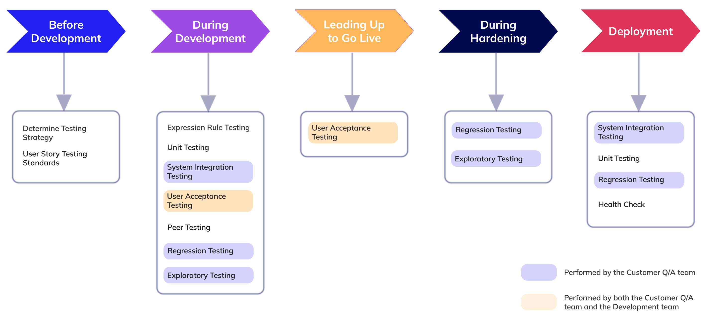





Our Appian Delivery Approach
Define Success - Use Application Vision Board Template
Explore Scope
Plan Release
Agree on a way of working
Identify Stakeholders
Define Persona
Current State Understanding
Create Product Backlog
Identify Design Constraints
Environment sizing
Prototype Ideas
Incremental Release Strategy
Create Release Plan
Agree on a way of working
Define Ready
Define Done
  Plan Sprint – Prioritize, Estimate, Team Velocity
  Refine Backlog
  Just-in-time requirements analysis
Initiate
Define Scope
Plan Release
Build Start with Agile Planning
00
01
02
03
  Established Deployment pipeline
  Development - all development activities and story-level testing are performed in this environment.
  Test – Functional Testing, Integration testing, UAT and NFR
  Development of Workfow
  Daily Standup
  Create test plan and design
  Break story into tasks
  Appian Design of Objects
  Test Story, Demo
  Peer Review, CoE Review
  Acceptance by PO
Deploy & Test
Disciplined Development
05
04
  Ensure Readiness – Technical Readiness (E2E Functional test, Stakeholder Satisfaction, Data Migration, Deployment Planning, Concurrent Load Testing, Provision users)
  Prepare Business for change, Support Team, Train Users, Train the trainer
  Incremental Roll out – Pilot Release, Read-only Release, Parallel Run
  Review with Release Checklist
  Effective Application Support
  Regular Health Check
  Collect Feedback
  Measure Impact & celebrate success
  Measure Impact, Communicate Impact,
  Inspect and Adapt based on learning from Sprint Review
  Retrospective Meeting at the end of each sprint
  Define Retro Agenda
7
Adapt
Release
Optimize
06
07
08

Slide 8














Our Execution Approach
Initiate
Define
Build, Deploy & Test
UAT
Production Release
Iterations
Technical Feasibility Evaluation
Portal
Workshops
Style Guide
Wireframe
Workflow Creation
QA & User Acceptance
Epics, Features & User stories
Refined requirements and design
Interfaces
Interviews
Quick Mockups/Interfaces
API Development
Regression Testing
Agile
Iterative Feature Releases
Show & Tell sessions
The development process is User Centric with emphasis on User Experience and Quality Assurance

Slide 9
Our Appian Offering
Elevate Enterprise - Reimagine Process Automation embracing GenAI
Accelerate Craft - Accelerate Application build using Applify.AI
Compute Revive - EUC Remediation using Appian
Not just Automation, but AI powered Automation to process Intricate Documents using LTIM Appian AI Starter Kit
Build your next generation Application in record speed using GenAI based accelerator Applify.AI.
Re-Invent Business Process backed by Experience Connect to redefine user journey to remediate EUCs.
90% Reduction in Manual Processing
40% Reduction in AI Journey with Starter Kit
30% Reduction in Application Build
40% Savings in process discovery using Applify.AI
40% increase in Operation Efficiency
60% reduction in manual and redundant processes
Appian Launch Pad - Bring Appian to your Enterprise
Appian Govern360 - Establish governance through Appian CoE
Adopt Appian to deliver continuous value to Business In record speed.
Bring Reusability, Scalability, Governance, End to End Ownership, Continuous Improvements and better Collaboration by establishing Appian CoE.
Deliver MVP in 3 Months
Operational POD in 2 Months
40% Savings through reusability
20% Delivery Cost Reduction

Slide 10







Our Appian Services
Experience Connect
AI Innovate
For integration within the experience ecosystem, focusing on seamless user experience, connectivity and integration
For prototype development, emphasizing innovation and cutting-edge solutions like AI
Complete Care
Synergy
For managed service-based delivery, emphasizing comprehensive implementation, care and management
For multi-vendor scenarios, highlighting collaboration and synergy delivering assigned set of work.
Support Plus
Modernize
For support projects, indicating enhanced support and continuous improvement.
Modernize Appian platform by upgrading to latest cloud native Appian version
Re-Invent
Guide Customer using process consulting capabilities to redefine and automate Business Processes to bring value @ scale

Slide 11




Broad level Solution Areas
Build New
Extend Existing
Connect to Enterprise
Modernize
Create new Enterprise solutions for process orchestration, automation, and intelligence
Extend current systems with AI and Hyper-automation capabilities to automate anything
Connect People with Systems to provide holistic solutions with improved customer experience and operation efficiencies
Modernize Appian platform by upgrading to latest cloud native Appian version
Re-imagine Automation
Consulting offering to transform business processes to bring value @ scale

Slide 12




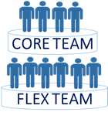

Our Engagements with Customers
Resource Augmentation
Co-Sourcing
Managed Services
Dedicated Centre
Core Flex Model
Engagement Models
Combined efforts of internal and external partners with customized services
Dedicated Offshore/ nearshore development center
Scale up and scale down the project resources based on the demand
Niche Automation skilled resource provisioning based on requirements
End to end automation services - Discovery to maintenance
Project
$
Complexity based
Outcome / Value based
Hybrid
€
£
Commercial Models
Pricing based on SOW, Project, Rate Card. Rate can be Skill, Role based or Use Case based
Catalog based fixed pricing per Process complexity, T-shirt sizing for Simple, Medium or Complex process
Pricing based on agreed per outcome delivered - FTE Saves, TAT Reduction,
Efficiency Gains, Volumes Processed
Bespoke pricing model to suit the engagement need which can be a combination of the other models

Slide 13




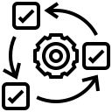

Focus on Accelerators & Frameworks
LTIM is a Professional Services Partner with Appian & also a Reseller Partner
ROI Calculator
Onboarding Co-Pilot
Applify.ai
Risk & Control Governance
AI Starter Kit
Calculates ROI of Appian solution
Indicates business benefits
Provides recommendations
AI driven Co-Pilot
Defines products and generates intake forms
Accelerates Onboarding
App build simplified infusing GenAI with low code
Convert requirement docs into workflows
Framework for EUC remediation
Helps in classifying EUC actions
Facilitates easy prioritization
AI driven classification of Mail and Document
Data extraction of different Form
Intelligent automatic handling of request
LTIM has a dedicated Appian Lab to develop solutions & perform R&D activities
Readily available industry standards, processes and best practices for successful Appian implementations
Best practices, templates & frameworks that can
save 30% BPM SDLC efforts
Notes:
Applify.AI App build simplified infusing GenAI with low code. Convert requirement docs into workflows.
AI Starter Kit for Mail Automation - AI driven classification of Mail and Document. Data extraction of different Form
Intelligent automatic handling of request.
Onboarding Co-Pilot - AI driven Co-Pilot. Defines products and generates intake forms. Accelerates Onboarding
Smart Fit Assessment - Gen AI infused Appian fitment analysis and ROI calculator

Slide 14









Applify.ai
Accelerate your digital transformation with Applify.ai – the fusion of low code development and Generative AI for innovative software solutions in record time.
Benefits
Rapid App Building
Increased Productivity
Significant Cost And Effort Reduction In MVP Implementation
Faster Understanding
Zero-touch Experience
Built on Appian Low Code platform, Applify.ai harnesses the power of GenAI to automate various aspects of the App build-out.
Low Code enables rapid application development with visual interfaces, pre-built components.,and minimal coding.

Slide 15





Few of our key implementations
    Appian CoE setup
    for a large US Bank
    Fiduciary Process Automation
    for a large US Bank
    Enhanced Onboarding Process For
    Investment Management Company
20% delivery cost reduction
40% savings through reusability
18+ Process automated
40% cost savings through automation
30% reduction in time needed for Data Update
20+ Handoffs automated
30% to 40% cost savings
Faster onboarding of Customers
Enhanced visibility and transparency
    Global Logistics Application for a Swedish
    Automotive Manufacturer
    Process Compliance & Auditing Solution
    For a Media & Entertainment Giant
    End-to-end business process automation for a Utility Corporation
60% Reduction in Manual and redundant processes
360° View of Data for better insights
40% efficiency through automation
24 x 7 platform and solution support
45% savings through reusability
18+ business process automations

Slide 16



Multiple engagements across LOBs for large US Bank including Appian CoE Setup, Fiduciary Process Automation etc.
Benefits
Process Areas
  20%
Loan Origination
Loan Management
Bank Payments & Card Operations
Fast Credit Lending Programs
SWIFT Cross Border Payments Case Resolutions
Small Business Lending
Trade Finance (ESG)
Connected Onboarding
Connected KYC
Disputes Management
Omnichannel Case Management
Product Lifecycle Management
End-User-Computing
LIBOR
Mergers & Acquisitions
CIP / KYC / EDD
Credit Risk Review
AML
Horizon Scanning
Trade Surveillance & Compliance
Score Card Planning
EUC Remediation
  Delivery Cost Reduction
  40%
  Savings through reusability
  18+
  Processes Automated

Slide 17

Global Logistics Application for a Swedish Automotive Manufacturer
LTIM is working on Logistics, Packaging, Asset Lifecycle Management, Risk Assessment, Inventory and Material Planning, Supply Chain Orchestration and many more
Benefits
Manufacturing
  60%
Engineering Innovation
Packaging and Labeling
Product Launch and Lifecycle Management
Asset Lifecycle Management
Inventory and Materials Planning
Logistics Management
Preventative Maintenance
Supply Chain Orchestration
Track and Trace
Turnaround Planning and Execution
Aftermarket Parts and Service
Dealer Incentives
Field Service Management
Financing Programs
Internal Audit
Quality Management System (QMS)
Supplier Quality Management
Warranty Management
Incident Management
Inspections Management
Regulatory Compliance
Contract Management
Employee and Contractor On-boarding
Finance Command Center
Human Resource Management
  Reduction in Manual and redundant processes
  Unified view of Data
  Operational Optimization

Slide 18

American Multinational Mass Media & Entertainment Conglomerate
Working on Auditing & Compliance Solution for ensuring adherence to International Labor Standards
Benefits
Process Areas
Supply Chain Management
Supply Chain Code of Conduct
Labor Standards Compliance
Human and Labor Rights
Environmental Protection and Conservation
Ethics and Responsible Business
Quality and Safety
Better Work Program
Company and Facility Management
Contract Management
Franchise and Merchandize Approval
Audit Review and Management
Program Administration
Audit Scheduling
Invoice Generation and Payment
Product Management
Order-to-Activation
Retail Store Service
Service Distribution Management
Field Service Management
Inventory & Merchandise Planning
Store Lifecycle Management
Digital Distribution Workflow
Licensing Management
Marketing and Campaign Planning
Advertising Sales & Delivery
Intellectual Property Lifecycle
  1000+
  Users Globally
  24x7
  Platform and Solution Support
  40%
  Efficiency through Automation

Slide 19
Key Appian Success Stories

Slide 20






Appian COE setup for a large US Bank
Client Challenges
What LTIMindtree Did
  Lack of thought Leadership and Governance
  Prioritization of the use cases
  Non-alignment to Org strategic initiatives
  Lack of Scalability and Efficiency
  Non-adherence to Standards and Best practices
  Longer cycles for Skill Development & upliftment
Appian COE was setup
to streamline use case prioritization and governance
COE defined various processes to address the client challenges on skill development, standardization and reusability
Benefits
Industry – BFSI
  20%
  40%
  18+
  Delivery Cost Reduction
  Savings through reusability
  Processes Automated
Technologies – Appian, SQL Server, Client custom tools
Employees – 5,000+

Slide 21



Fiduciary Process Automation for a large US Bank
Client Challenges
What LTIMindtree Did
  The Fiduciary processes of the bank were highly manual and task intensive.
  Due to varied nature of data used in these manual process, scalability and data security was a challenge.
  Auditing is challenging due to manual intervention
  Complex validation rules
End-to-End Process Automation using maker-checker flow for various EUC's. Remediated risks related to data and auditing
Better governance on Appian
Enhanced Reporting Capability. Custom view configurations along with dynamic filters .Automated Validation rules
Benefits
Industry – BFSI
  40%
  30%
  20+
  Cost savings through Automation
  Reduction in time needed for Data Update
  Handoffs Automated
Technologies – Appian, Xceptor, SQL
Employees – 5,000+

Slide 22
Deal Onboarding for a large US Bank
Client Challenges
What LTIMindtree Did
  Lack of management system to create deals from the CRM system, processing them in an end-to-end application, and managing documentation and KYC processes
  Integration challenges with existing systems like CRM and document management systems.
  Automating the creation and management of deals
  Expanding the application usage globally
Developed a Deal Management System from scratch, integrating with CRM using Kafka for messaging services.
The solution includes dashboards, document installation, and automation of deal creation and management processes.
Integrations include CRM, ATL, and DMC systems
The system is designed to be used globally, starting with India and the APAC region, with plans to expand to other regions.
Implementation of CI/CD for deployment to streamline and automate the process.
Benefits
  Effective management of the deal creation and documentation process, improving efficiency.
  Automation of processes reduces manual effort and potential errors.
  The solution provides a unified platform for deal management, accessible globally, enhancing collaboration and consistency.
  Improved quality control through peer reviews and QA processes, ensuring defect-free releases
Industry – BFS
Technologies – Appian
Notes:
The Deal Onboarding process, which is part of Issuer Services group, is about commercial client onboarding, KYC process and transactions management. The Issuer Service Sales Support is a part of the deal onboarding process. The process is end-to-end, and starts from winning the deal to onboarding the client. The deals are for various companies and may include Corporate Debt, Structured Finance, Specialized Agency, Loans and Project Finance, Repacks. Once a deal is won, it is put into an end-to-end application to ensure successful onboarding.

Slide 23



Enhanced Onboarding process using Appian BPM
Client Challenges
What LTIMindtree Did
  Manual Onboarding process
  In silos with no visibility of onboarding status
  Lack of centralized document repository
  Higher TCO and inefficient operations
Appian based solution to streamline dependencies
and task assignment
Templates and tasks forms specific to business units
Automate multiple steps of processes , efficient task assignment and queue management
Benefits
Industry – BFSI
  Enhanced Visibility/Transparency
  30 - 40 %
Technologies – Appian
  Faster Onboarding of clients
  Cost Savings
  Centralized Document repository
Employees – 8,000+
Notes:
Lord Abette

Slide 24



Process Compliance and Auditing Solution For A Leading Media & Entertainment Giant
Client Challenges
What LTIMindtree Did
  40,000+ Facilities across 200+ countries producing customer branded products
  Lack of monitoring and traceability across the onboarding process and compliance to International Labor Standards
Implemented an Appian based solution to handle the entire Auditing lifecycle
Company & facility onboarding, starting production, conducting periodic audits & related actions.
Complete managed services including implementation, platform upgrade and maintenance
Benefits
  1000+
  24 x 7
  40%
Industry –
Media & Entertainment
  Users Globally
  Platform and Solution Support
  Efficiency through Automation
Technologies –
Appian, Selectica EDH
Notes:
Walt Disney

Slide 25



Global Logistics Portal for a Swedish Automotive Manufacturer
Client Challenges
What LTIMindtree Did
  Multiple discrete systems for Material Planning & Procurement
  Lack of a single user interface for end-to-end procurement process execution
  Multiple manual & redundant steps
Appian based solution to interact with multiple systems.
Created 3 modules to handle Material Planning & Procurement Process – Buffer Handling, Warning Handling and Shortage Handling.
Benefits
Developed integration mechanism to fetch data from multiple sources.
  60%
  Single Unified view of Data
Industry –
Automative Manufacturing
  Reduction in Manual and redundant processes
Technologies –
Appian
  Ability to create dynamic dashboards
  & reports
Employees – 800+
Notes:
Scania

Slide 26

Health Insurance Appeals Automation using Appian AI
Client Challenges
What LTIMindtree Did
  Multiple discrete systems for appeal creation and closure
  Lack of a single user interface for end-to-end appeal resolution mechanism
  Multiple manual & redundant steps by appeals specialist
  Severe backlog of cases.
Appian based solution to interact with multiple systems.
Created 4 modules to handle Complaints and Appeals Process – Automatic Intake of Documents, Case Creation, Case Acknowledgement and Decision Handling.
Benefits
Developed integration mechanism to fetch data from multiple sources.
  70%
  Unified view of Data reduced cycle time and avoided duplicate processing
Industry –
Health Insurance
  Reduction in Manual and redundant processes
Technologies –
Appian
  Holistic insights enabled guided steps and intelligent decisioning
Employees – 2000+
Notes:
Premera

Slide 27
Mail Automation using Appian AI for one of the largest Investment Management Organization
Client Challenges
What LTIMindtree Did
  Miss classification of Email and Document
  Lack of end to end traceability of request
  Multiple manual & redundant steps
  Severe backlog of Mails.
Appian based solution to classify the Email with Attachments and extract details.
Leverage Appian AI Starter Toolkit with Appian Skill (Document Classification, Document Creation, Email Classification, Email Extraction, Gen AI etc.).
Projected Benefits
Developed integration mechanism to fetch data from multiple sources.
  80%
  Classify 90% of the Emails and Document automatically
Industry –
Banking
  Reduction in Manual and redundant processes
Technologies –
Appian
  Auto verification of Document and identify NIGO Scenarios
Employees – 7500+
Notes:
Capital Group

Slide 28
Getting to the
future, faster.
Together.

Slide 29
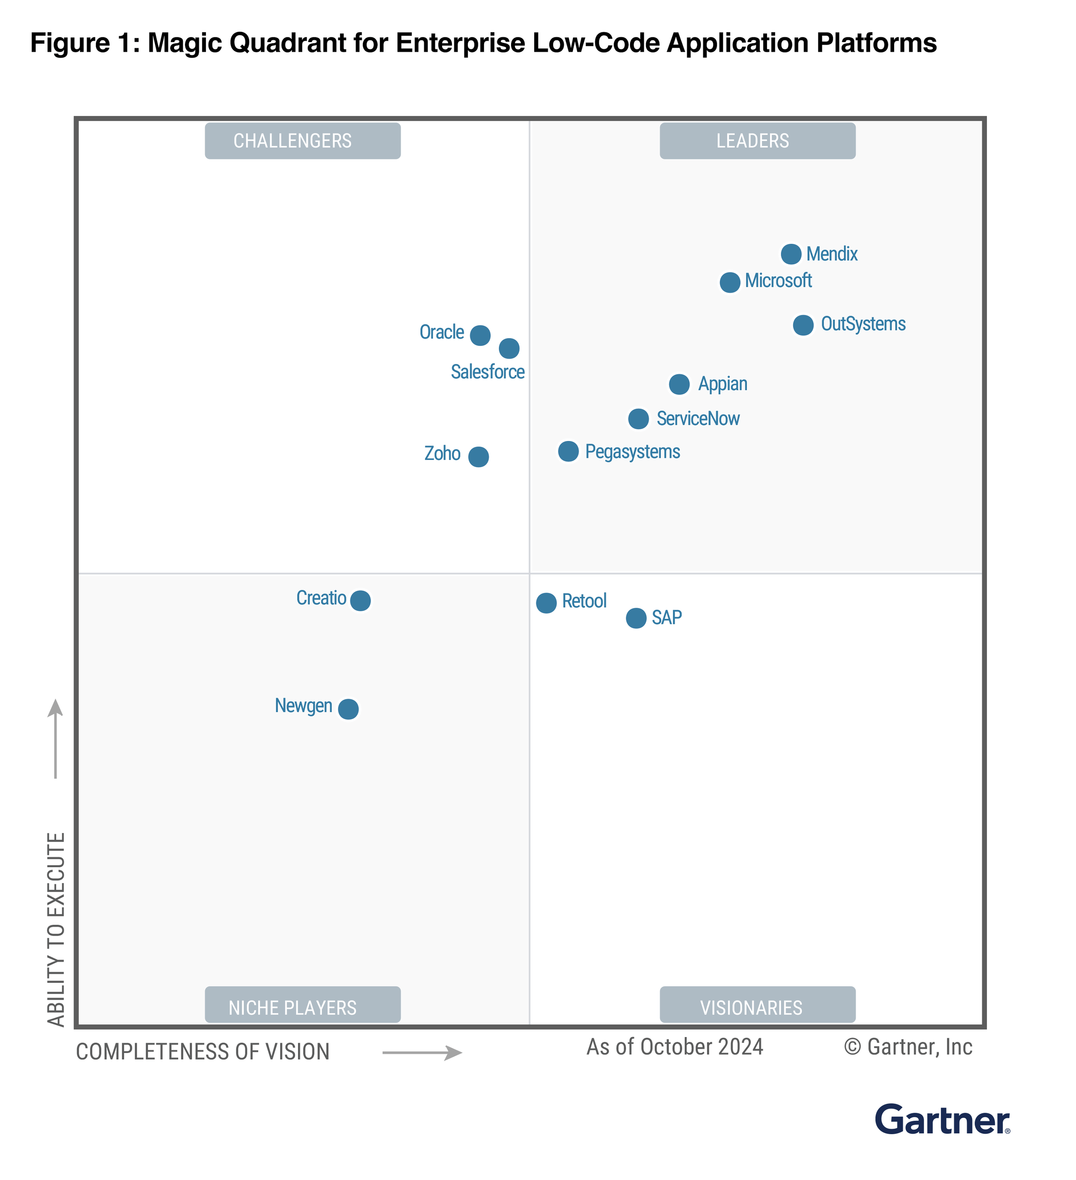
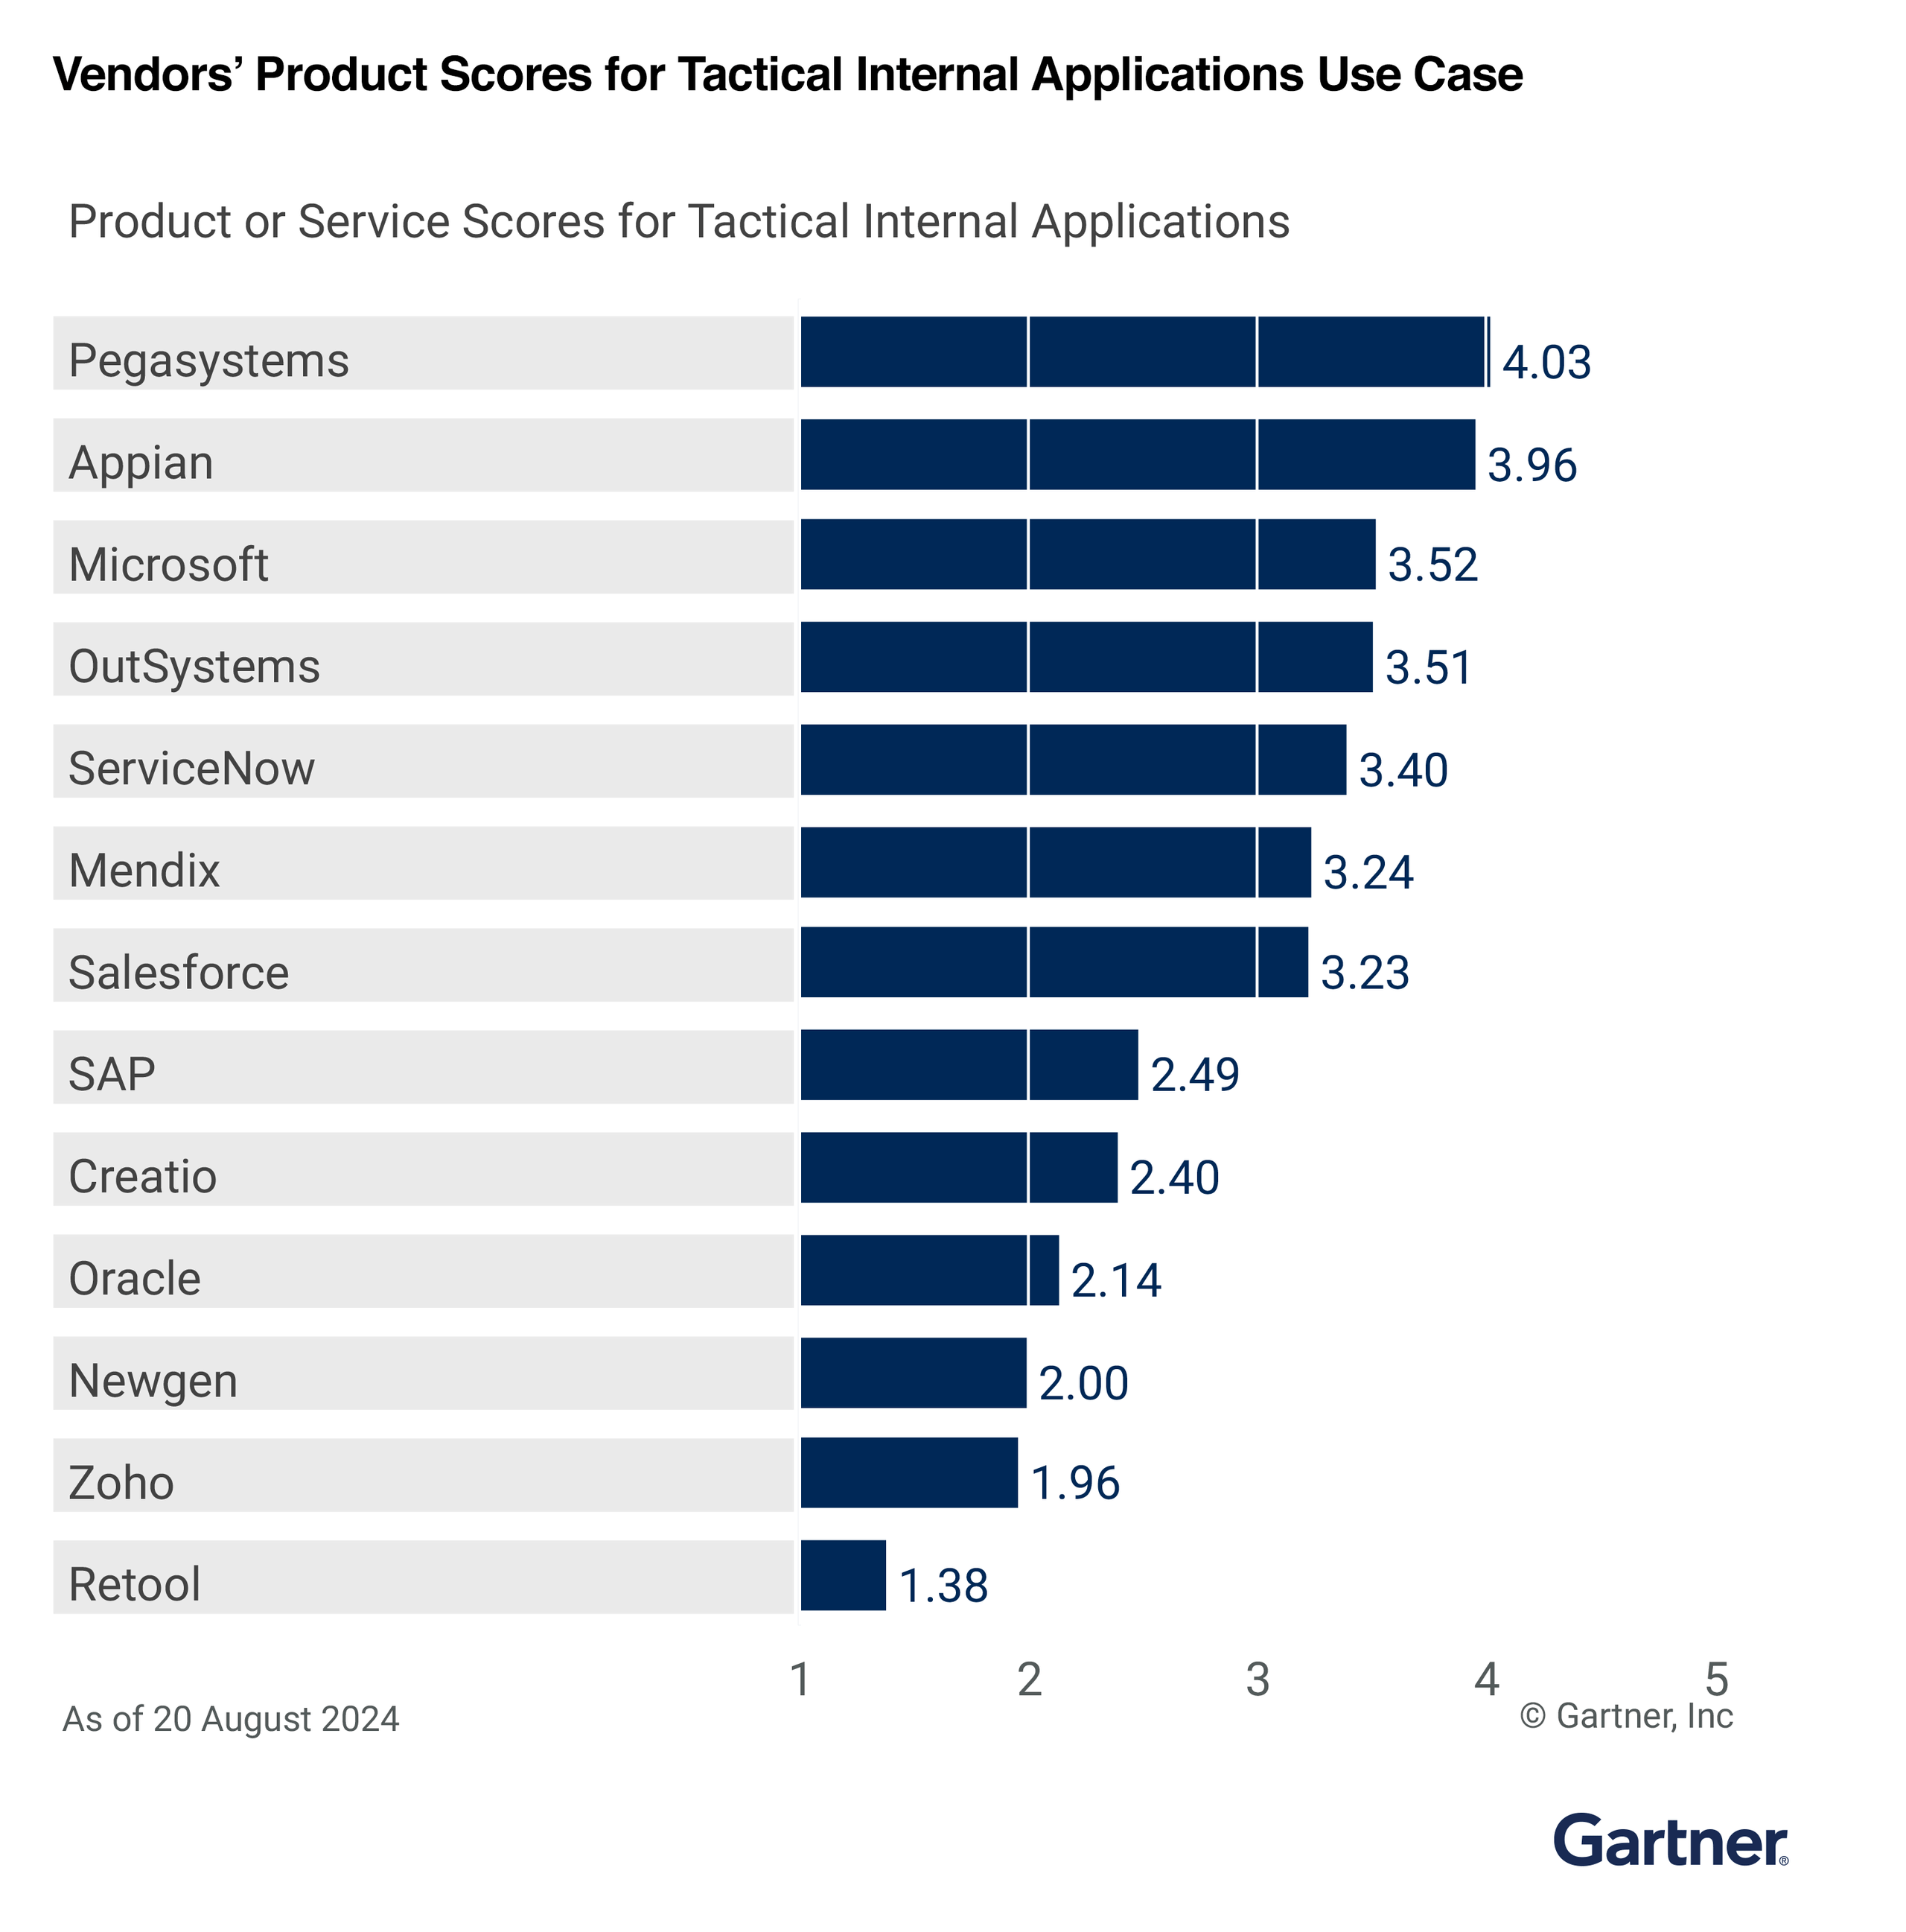
Analyst Report
2024 Gartner® Magic Quadrant™ for Enterprise Low-code Application Platforms (LCAP)
Gartner Critical Capabilities for Enterprise Low-Code Application Platforms (LCAP) 2024

