Slide 1


LTIMindtree Lending and nCino Capability
Jun 2025

Slide 2


LTIM Overview and Lending Capabilities

Slide 3

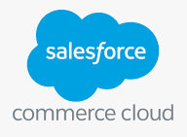














LTIM Lending Practice Overview
LTIMindtree specializes in digital transformation of end-to-end lending value chain across Retail & Commercial banks modernizing their lending operations and customer experience via business process re-engineering, re-designing infrastructure and implementing cutting edge solutions. We are the strategic partner for major Retail & Commercial banks to transform their lending practices, persevering its DNA as a nimble technology company with one eye on its legacy and founding principles while continuing to power an ever-changing business landscape.
1500+
Lending Practice Size
150+
Lending SME
30+
Solution Implementations
20+
End to end Lending Transformation projects
Lending domain consulting
Innovation and co-development
Product partnership and collaboration
Strategic Partnerships
LTIMindtree IPs
Expertise
Offerings
Certified Experts & SMEs
Retail lending
Commercial lending
Syndicated lending
Embedded/POS Lending
Sustainable Financing
SME/SBA Lending
Payments
Credit Risk Assessment
KYC Compliance
Customer Engagement
Lending Lifecycle Implementation
Customer 360
Loan reconciliation
Leasing
Instant Loan Origination and Onboarding (Pega)
Lending Process Reimagine & Transformation
Advanced Loan Servicing System Implementation
SBA Lending system implementation for PPP Loans.
POS Lending solution (BNPL)
Alternative data-based credit decisioning solution
AI Chat Bot Solutions for Personal & SME Loans
Early warning System for probable loan defaults (Customer360)
Smart reconciliation management solution (tooki taki)
Intelligent Document management solution (capital quant)
Modern Digital Collection Management Solution (HSBC)
Cloud based End-to-End Lending Solution
ESG & Sustainable Financing
Lease Management Solution
Turbo Lending
Accelerators & Reusable Assets
Financial Engine for Wellbeing
Product and Technology Partners
Specialized Service lines
Lending IP & Solutions
Platform led delivery
Operations & Services
Lending Applications Development and Maintenance
for a Mid Size Corporate Bank in USA
Application Maintenance and Support Services
for a US based Mid-sized Corporate Bank
Automation of Commercial Loan System (CLOS) with integration of BPM, BRMS and DMS
for one of the largest regional banks in the US

Slide 4


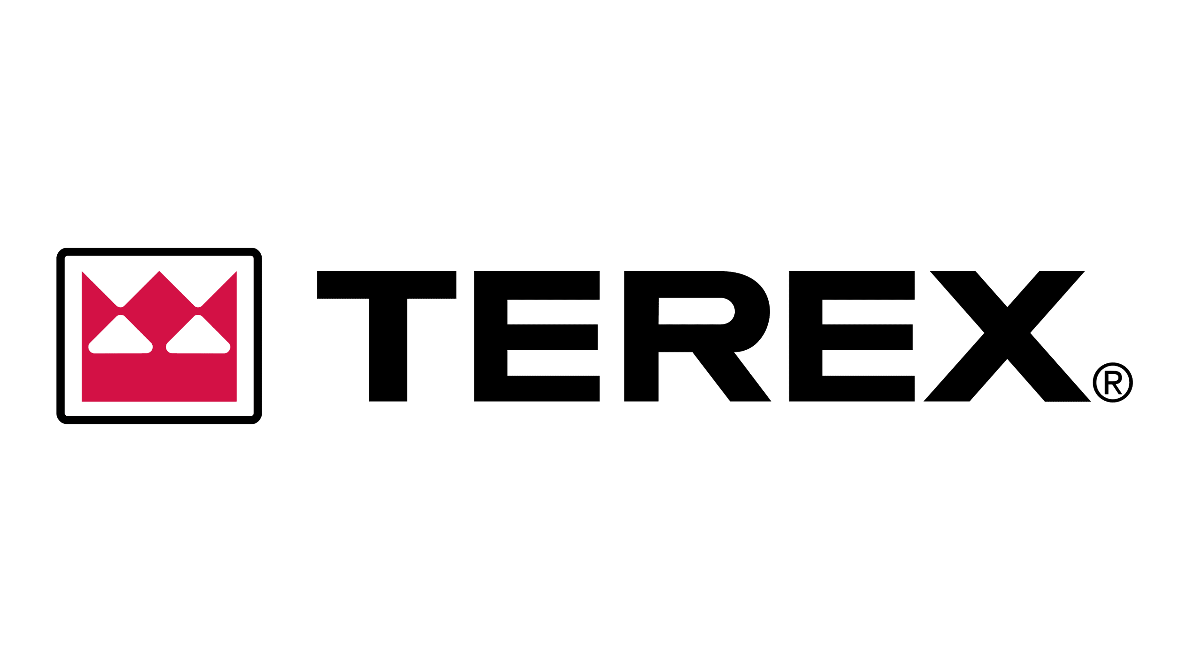




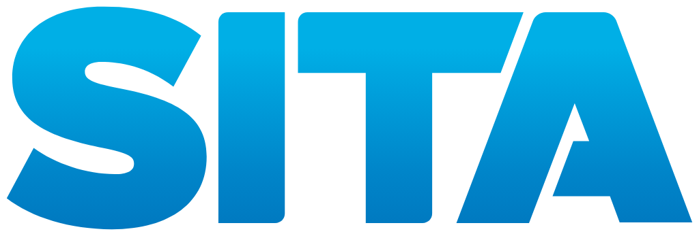



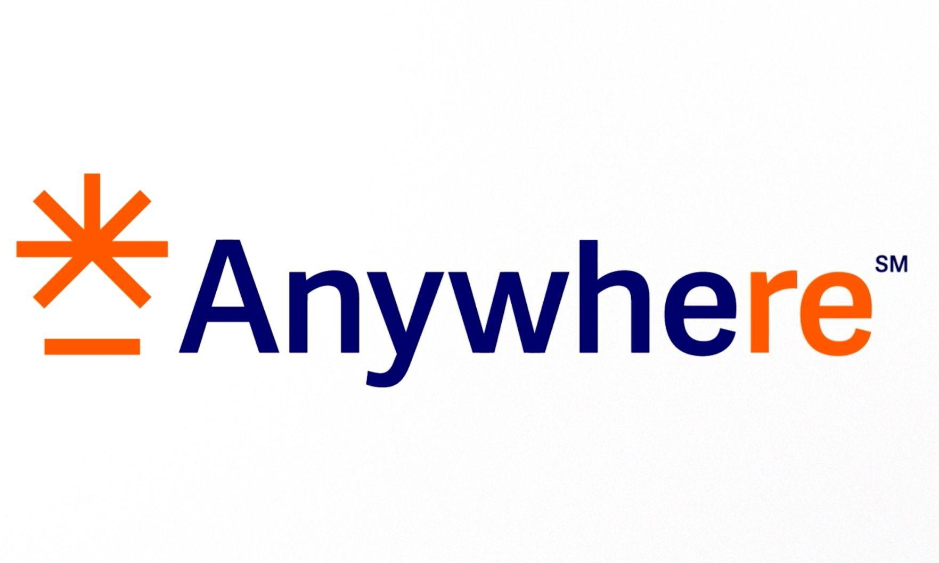

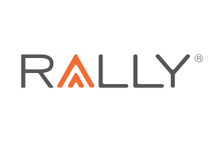








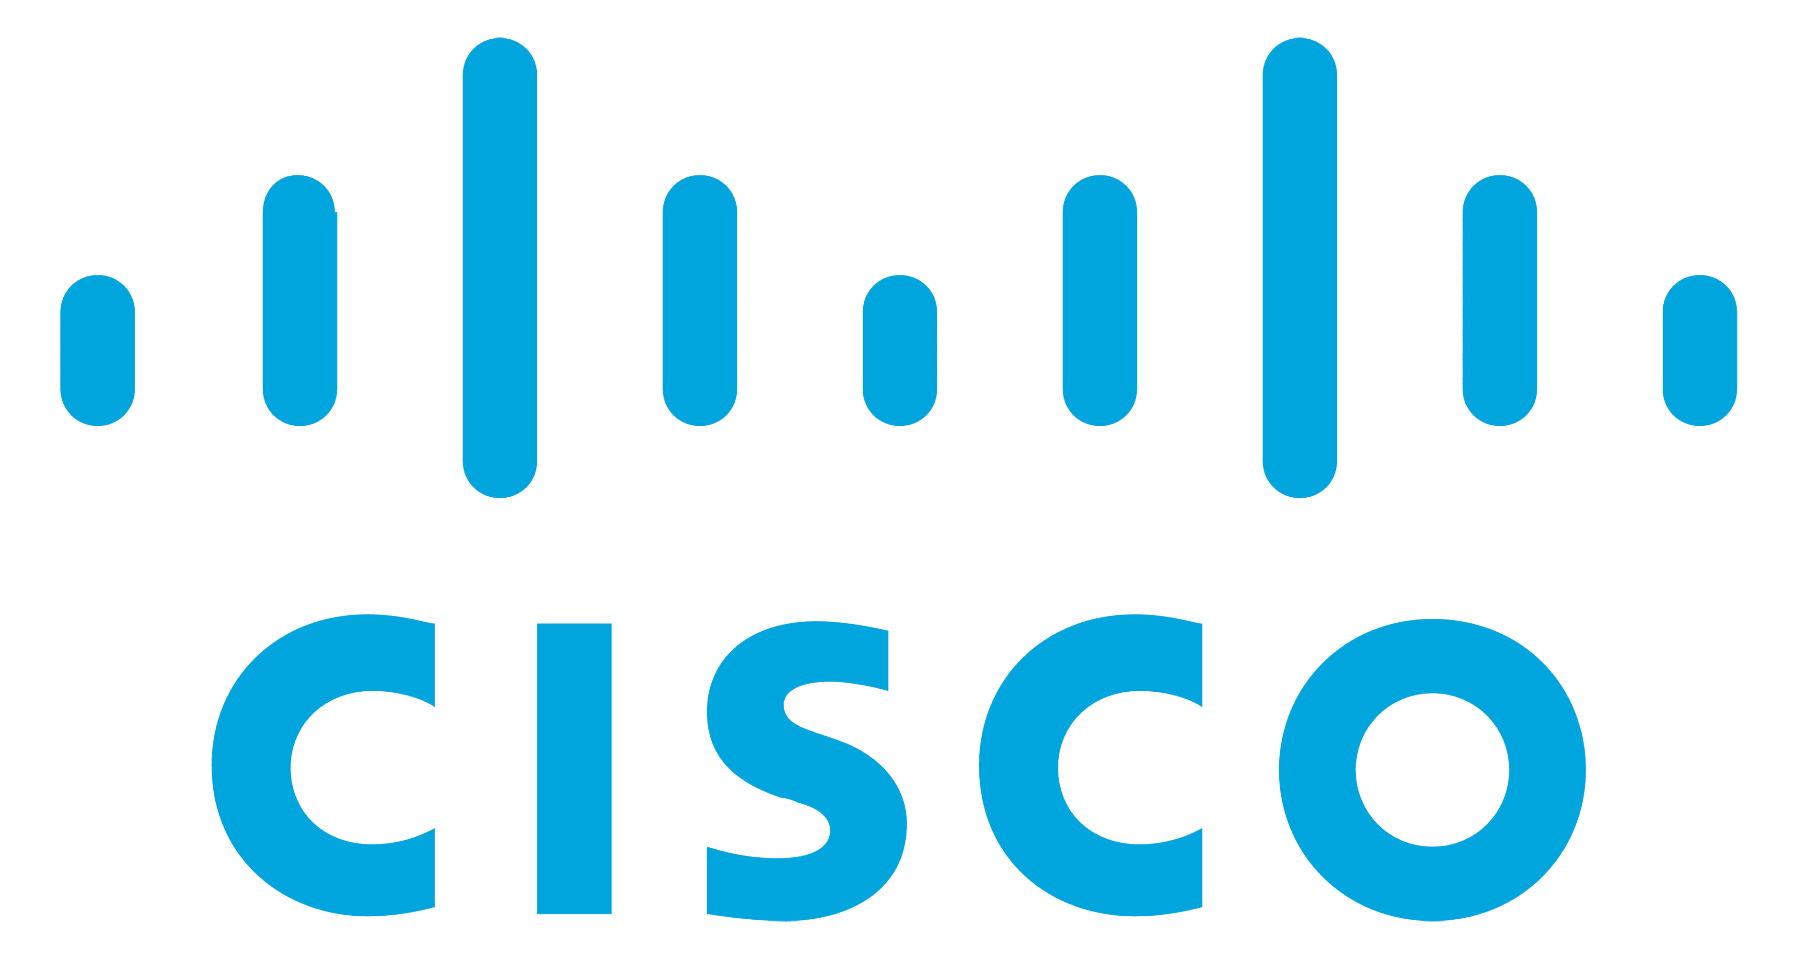



















Salesforce: Capability overview
Field Service
Asset tracking and management, Scheduling and task management, Mobile workforce
CPQ
Pricing, Quoting, Order Management, Contract Management.
Platform + ISV
App rationalization, Low-code app development, App and Site management. ISVs – nCino, Veeva, Conga, Apttus, Zuora
Extended platform
Experience Cloud
Dealer portals, Consumer portals, Employee portals, Custom applications
Field service
Commerce
Full Commerce Services – B2B & B2C; Strategy, QuickStart implementations, Customizations, Integrated portals, Headless portals
CPQ
Platform
Communities
Commerce
Marketing Cloud
Marketing outreach, Omnichannel engagement, Campaign management, Upsell, Cross-sell
Industry Clouds
Services on Financial Services cloud, Health cloud, Manufacturing cloud, Consumer Goods cloud, Auto cloud, Media cloud & Education cloud
Marketing
Industry
Industries
Core platform
Centers of Excellence
Analytics
and
Integration
Core – Sales and Service Clouds
Lead management, Forecasting, Territory management, Case management, Service Console, Knowledge management
Sales &
Service
Analytics & Integration
Leverage data, analytics and AI to predict outcomes and drive actions; Put actionable analytics and rich data insights
within reach

Slide 5



Our nCino Footprint in Lending Transformation
Business Analysis services
Changing & expanding the way FIs interact with customers
Improving regulatory compliance
End-to-end IT Services
OPPORTUNITIES
OFFERINGS
Delivering a true competitive advantage
Implementation
Optimize Business Processes
Enabling data analytics and business intelligence
Quality engineering
Driving revenue growth and efficiency
Production Support & Maintenance
Profitability
Increase loan and deposit volume while reducing closing times.
Efficiency
Increased staff efficiency and utilization with reductions in operating costs and regulatory preparation.
Simplicity
Consolidates multiple banking systems into one and delivers an intuitive software interface.
Digital Engagement
Merges digital engagement between the employee and customer through a single digital platform.
Safety and Soundness
Acts as a risk mitigator and early warning system through reductions.
Data Analytics
Centralize data and provide detailed dashboards and reporting across all business lines.
Value

Slide 6
Our Relevant Experience

Slide 7




LTIMindtree & SVB nCino Journey
Overview
SVB is a mid-sized Corporate Bank based out of the U.S offering Commercial and Retail Banking services in US and UK Markets with $33B in assets, and operations in 34 locations worldwide. LTIMindtree is involved in SVB Private Bank: nCino Enhancements & Development 2023 initiative.
Scope
Q1
Q2
  Loan autoboarding
  Docusign Integration
  Implementation of Dual Risk Rating
  nCino upgrades
  Backlog
  TDR replacement
  nCino upgrades
  Redesign of Specialty Commercial credit memos
  Enhanced reports/build out of dashboards
  Update Specialty Commercial approval processes
  Refine and update annual review and CRR changes process
  Onboarding of CDF to nCino and
  Private Bank tech stack
  Real time calls to Reg O/Reg W database
  Core conversion updates
  Build out of deposit account disclosures in nCino and decommission Wolters Kluwer Integration
  Conversion from Visa to MasterCard
Q3
Deliver Portfolio Features for SVB
Support Production Issues
BAU Enhancements for nCino
EDW Data Support from nCino
Requirement
Solution
How LTIMindtree helped SVB in its nCino Journey
Update existing loan validation rule
Add deposit form qen in DAO Workflow
Add borrowing base route to the renewal/mod process
Add additional Covenant Compliance record Data-point
Update BEFD logic
Add New Borrower Type at Loan level
New field for Third Party Reports and update rule
Add recall option to Cov Compliance Records
Support Production Issues
Mapping APIs is in progress for Consumer BDA

Slide 8
LTIMindtree & Synovus nCino Engagement
Overview
Synovus is one of the largest regional banks in the US. Customized nCino packaged solution is being used for commercial loan origination system in Synovus since 2022. Currently, implemented for Wholesale, Retail, Commercial and SBA lines of business covering different type of products.
Scope
Synovus classify loans into scored loans & unscored loans
  Scored loans (Wholesale, Commercial, Small Business) : Risk scoring is initiated by nCino which talks to ADM system and ADM system gets risk grade from Equifax.
  Unscored loans (Retail) – nCino direct interfaces with Equifax for risk grade details.
  nCino LOS system has to be integrated with multiple downstream and upstream systems
FIS – core banking (for Booking the loan)
LWB – collateral management system
Equifax : for credit report
ADM- TSYS (Credit score For Scored loan)
JHA Synergy (Document management system)
E-Tran (SBA Loan)
Data Warehouse
DocuSign
Wolter Kluwer (Loan document generation)
Requirement
Solution
Currently LTIMindtree is managing BAU and Technical support track with below roles and responsibilities.
Gathering requirement for the nCino LOS enhancement
Design, implement, configure and rollout to production
Handling all the org: Org refresh, setting up nCino org, RBC configuration etc
Handling DevOps process
Repository management
Deployment
Technical support
How LTIMindtree helped Synovus in its nCino Journey
LTIMindtree is an nCino implementation partner for Synovus.
Six resources from LTIMindtree are working on this journey. 3 resources offshore and 3 resources onshore (5 developers and 1 Architect).
Helped on FIS core system integration for loan Booking.
Helped on LWB (collateral management system) integration.
Worked on integration with Document Manager, Credit scoring system (ADM - TSYS) and Risk grading system (Equifax).
Worked on design review and code review.
Helped on Deployment process and setting up CI/CD using AutoRabit.

Slide 9




Commercial Lending – Automation of CLOS
Automation of Commercial Loan System (CLOS) with integration of BPM, BRMS and DMS
Client faced below challenges with its LOS: -
  Legacy workflow platform
  Loan Origination System not up to date
Bank’s different manual processes was making it difficult to process commercial loan quickly and efficiently.
Delays used to happen as an excel based application is used to manage loan process and approval steps uses official mail for communications.
Manual exchange of document had to be circulated for additional information and returned to originating branch to resume the loan approval process, resulting in the loan approval taking nearly a month time to complete.
Problem
Multiple Services provided as a managed service (Development, Maintenance, Production support, DBA, Independent Testing, Reporting
& Analytics)
Decommissioned 3rd party Workflow engine and built a custom Engine
Loan approval process was enhanced based on User / Reporting needs and Audit gap findings
Upgraded the technical legacy components to make the loan origination system up to date
Integrated Business Process Management(BPM), Business Rules management system(BRMS) and Document Management system(DMS)
Integration with bank’s Core Banking Solution and existing DMS​
Important compliances and regulations are the part of the loan approval process, bankers fills the loan requests online, borrower and guarantor information are fetched using 3rd party web services, customer data are safely stored, system notifications and emails are automatically generated as a part of the system
Solution
$50,000
License cost saving annually
Non-linear growth
of customer’s IT
Ease of extensibility and maintenance
Complete view
of the exposure to the customer
Fully Automated and Robust Workflow
ZERO
Data Inconsistency​
Benefits

Slide 10
Getting to the
future, faster.
Together.

Slide 11

Appendix

Slide 12






Areas of Integration for nCino
Some of the areas where we can integrate other solutions / third-party providers with nCino to provide better efficiency and enhance customer experience
Document Management Solution
Document Preparation Solution
Credit Bureau integration for Credit checks and Credit Reports
KYC/Identity verification integration
Government watchlists and Fraudlists Integration (AML)
Core Integration
Loan Servicing integration
CRM integration
Document ESignatures
Report Dashboards
Data Driven Insights
Lien Solutions (UCC Filing and searches and management)
Customer Engagement Apps like Chatbots etc
Flood Services
Account data
Borrower data
Benchmarking Data
Compliance Management
Small Business Data
Vehicle Valuation (Retail)
Jumio
Neener Analytics
Tookitaki
Capital Quant
Branddocs
Financial Engine for Wellbeing
Temenos T24
Plaid

