Slide 1

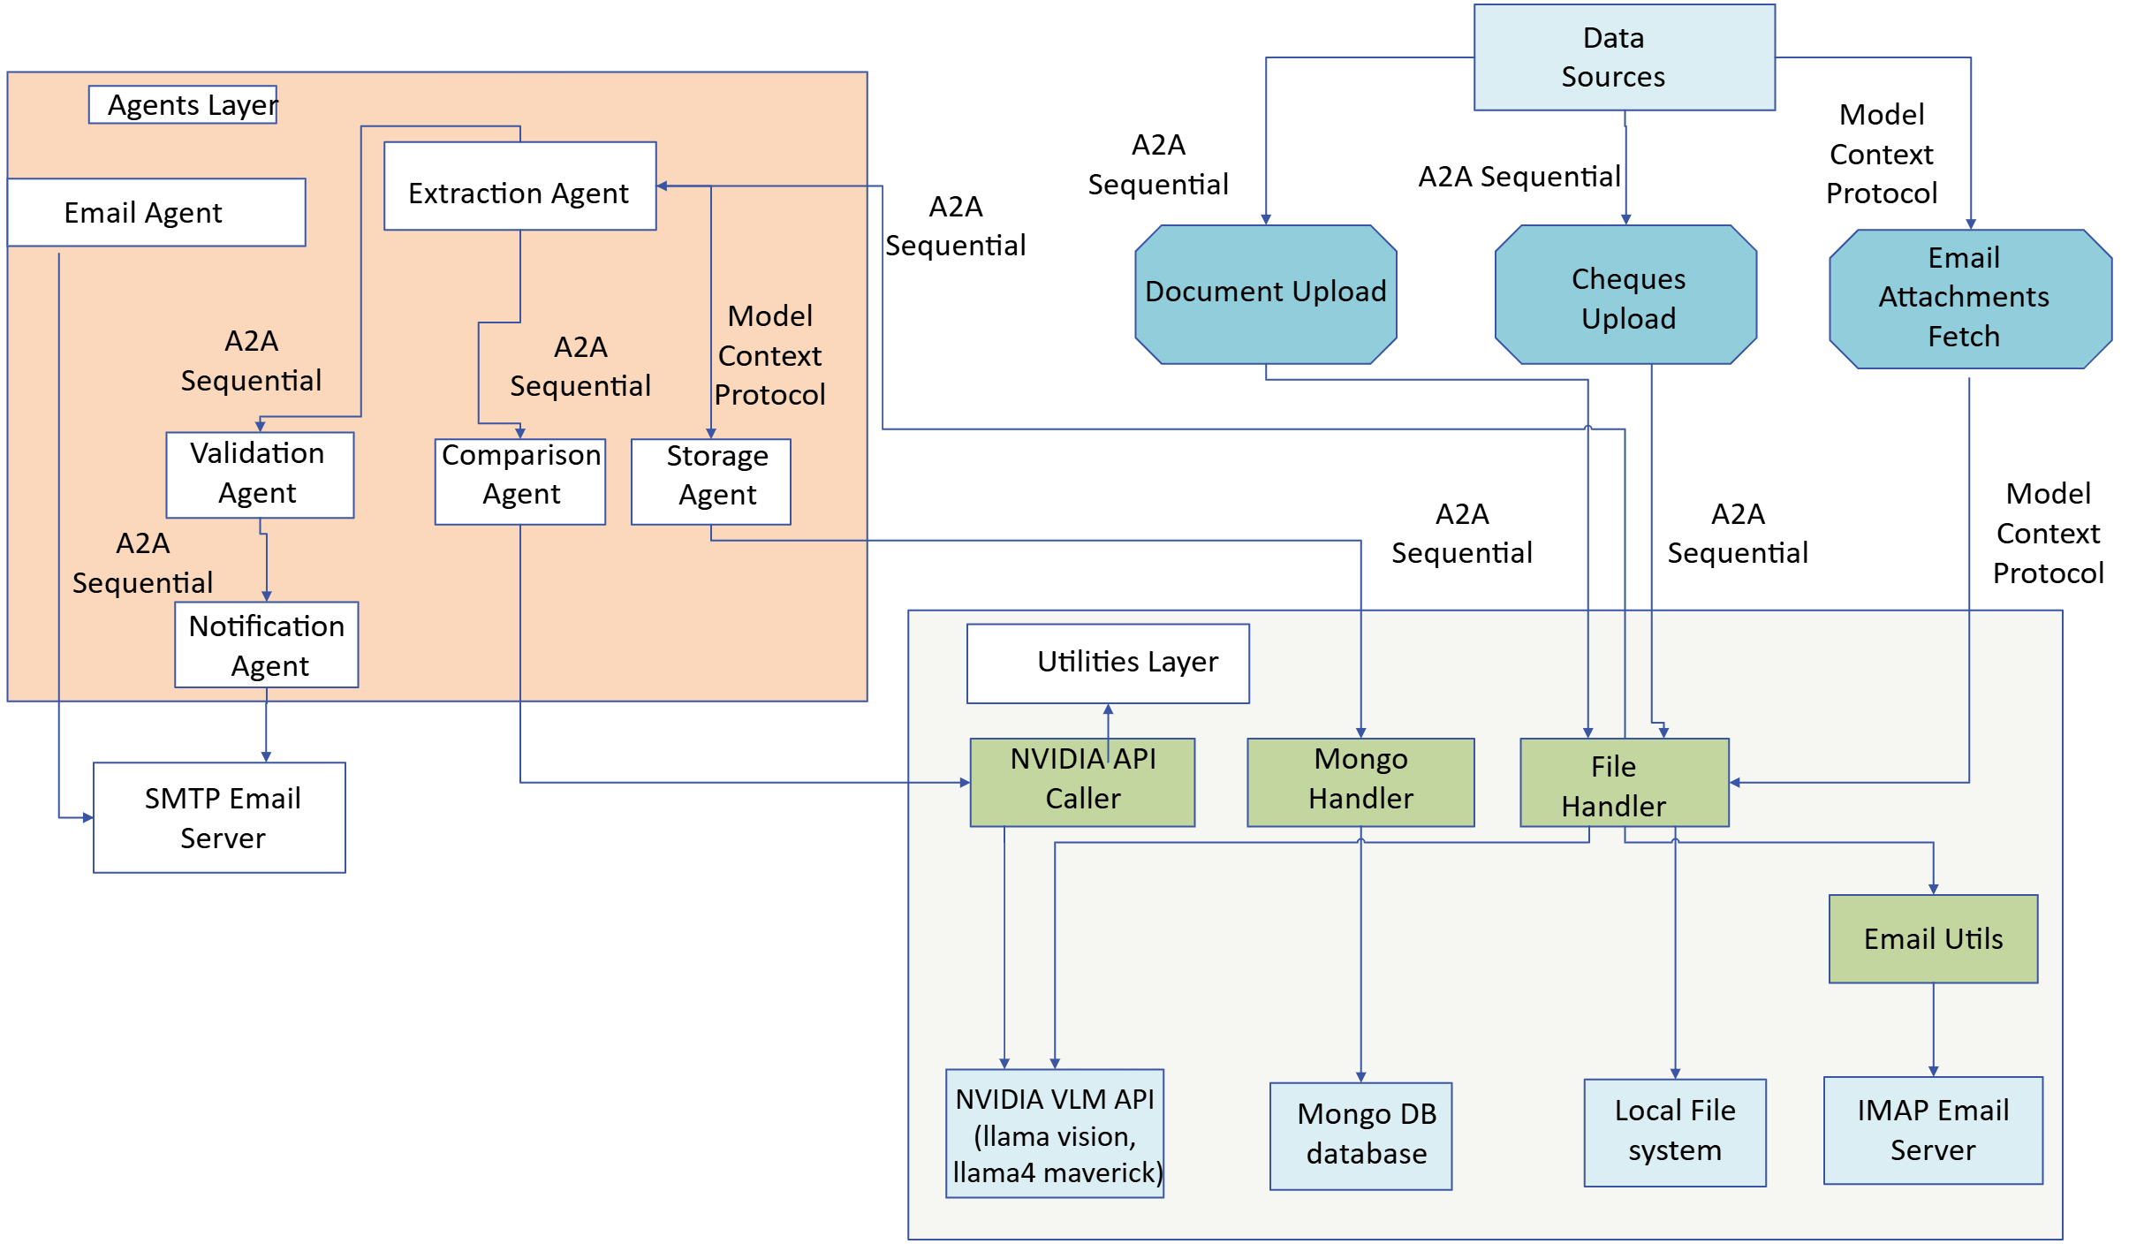
Document Digitizer
Objective
A tool that efficiently extracts text, signatures, and seals while validating their authenticity. This tool streamlines document processing with intelligent agents, ensuring accuracy and security in digital workflows.
Framework
Autogen/Agent IQ
Model Context Protocol(MCP)
NIM VLM
Langchain
FastAPI
Key Benefits
Agentic Orchestraction: The Agentic Orchestraction provides a secure and modular architecture that Streamlines operations with intelligent orchestration.
MCP Protocol: The Model Context Protocol (MCP) Replaces fragmented integrations with a single, reliable protocol Leveraging advanced AI models like Vision Language Models improves capabilities.
Automated Processes: By automating extractions and verification, the accelerator significantly reduces manual effort and processing time.
Intelligent Data Extraction: Multimodal AI with contextual understanding enables intelligent data extraction and auto-filling, even inferring missing information from documents.

Slide 2
Getting to the
future, faster.
Together.

