Slide 1


Appian Overview
© LTIMindtree | Privileged and Confidential 2025

Slide 2




Appian delivers End-to-End Intelligent Business Process Automation
1
Unleash digital innovation with low-code design.
Design
Automate
Automate end-to-end processes with a unified platform and induced AI.
2
3
Optimize business efficiency with process mining.
Optimize

Slide 3






We use Appian for
Rich User Experience
Hyper Automation based Solution
Build medium to complex Application
End to End Orchestration
High scaling Service Orchestration
Induce AI easily

Slide 4
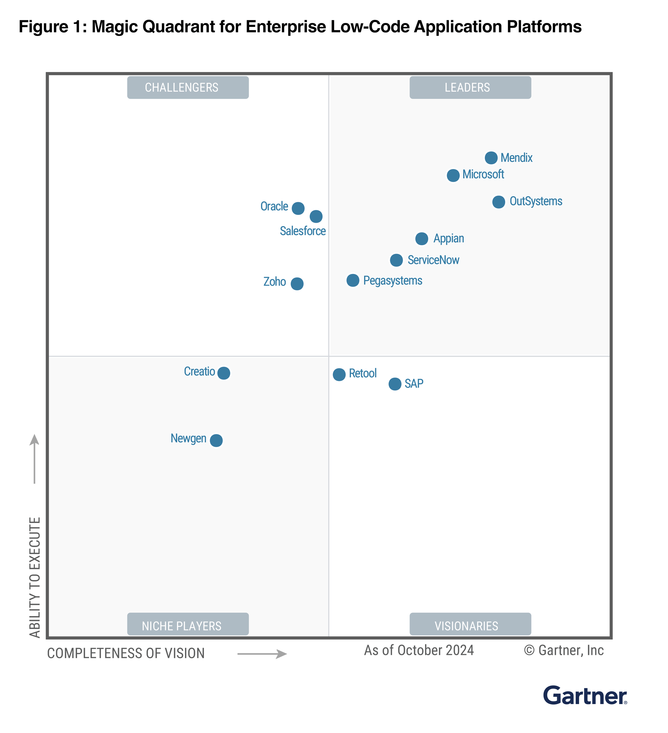
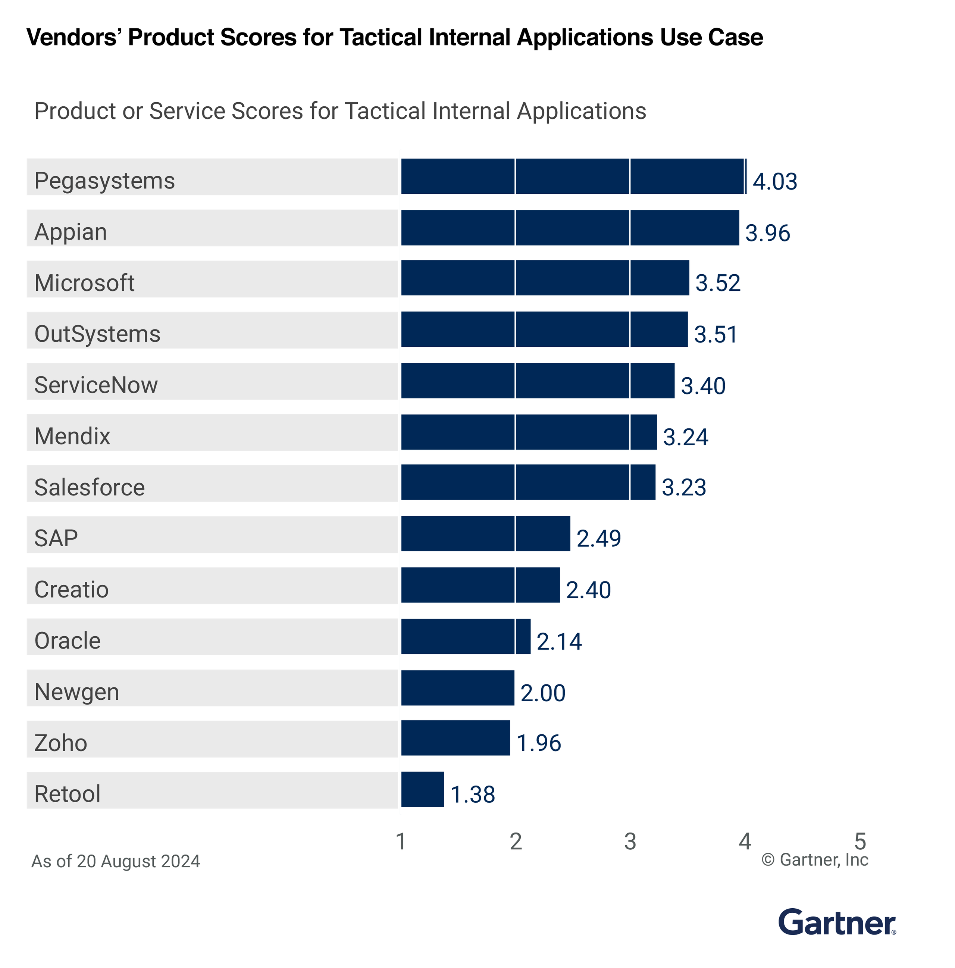
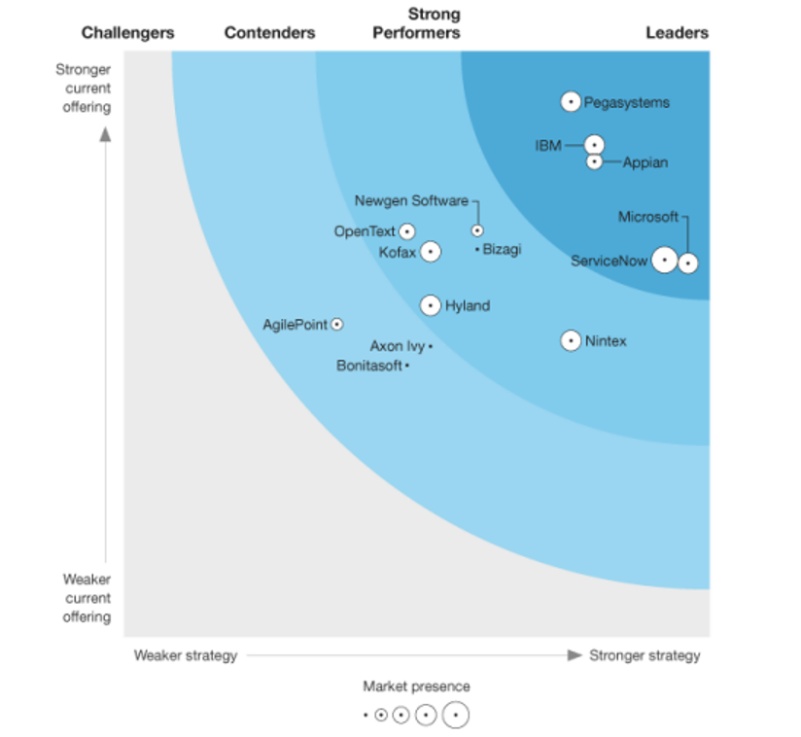

What Analyst is talking about Appian
Leader in Digital Process Automation
2024 Gartner® Magic Quadrant™ for Enterprise Low-code Application Platforms (LCAP)
Gartner Critical Capabilities for Enterprise Low-Code Application Platforms (LCAP) 2024

Slide 5
Appian AI Skills
Private AI
Highly Available
Security Compliant
Pre-built AI Agents
Business Co-Pilot
Developer Co-Pilot
Document Classification
Document Extraction
Email Classification
Address users' questions on Business specific information embedded inside Document, Process Data, Data sources etc.
Generate Record Data
PII Extraction from Document
PII Extraction from Text
PII Extraction from Email
Enterprise Co-Pilot
Text Summarization
Email Summarization
Email Extraction
Generate Test Cases
Records Chat
Document Summarization
Unstructured Document Extraction
Gen AI Prompt Builder
Generate Forms from PDF
Data Fabric Insights Copilot
Text Generation
Text Summarization
Text Extraction
Advanced IDP
Agentic AI RPA (Beta)
Agent Studio (Beta)
Smart Search (Future)
Generate Application through Chat (Future)

Slide 6



Appian AI Skills
Generative AI Skill
Business Co-Pilot
Developer Co-Pilot
Placeholder for text Placeholder for text
Placeholder for text
AI Co Pilot for Users enables your users to learn more about the wealth of information you organization contains.
Developers can partner with AI Copilot to build interfaces and process models quicker and easier.

Slide 7
Appian AI Skills
Alternative Design Option
Generative AI Skill
Business Co-Pilot
Developer Co-Pilot
Placeholder for text Placeholder for text
Placeholder for text
Placeholder for text Placeholder for text
Placeholder for text
Placeholder for text Placeholder for text
Placeholder for text

Slide 8














Generative AI Skill
Document Classification
Document Extraction
Email Classification
PII Extraction from Document
PII Extraction from Text
PII Extraction from Email
Text Summarization
Email Summarization
Email Extraction
Unstructured Document Extraction
Document Summarization
Case Routing
Text Generation
Text Classification
Text Extraction
Gen AI Prompt Builder

Slide 9


Business Co-Pilot
Address users' questions on Business specific information embedded inside Document, Process Data, Data sources etc.
Enterprise Co-Pilot
Data Fabric Insights Copilot
Access institutional knowledge
Gain real-time insights about data, uncover potential improvements
Records Chat
Ask Question about Record, Smart Search for semantic serach

Slide 10




Developer Co-Pilot
Generate Record Data
Generate Forms from PDF
Generate sample data for record types
Build interface quickly using Gen AI
Generate Test Cases
Generate Application through Chat (Future)
Elevate your expression rule testing using AI-created test cases
Placeholder for text

Slide 11
Our Appian Capabilities
© LTIMindtree | Privileged and Confidential 2025

Slide 12











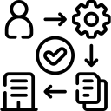

An expert in delivering Appian based solution
Leveraging synergy of stronger low code practice
3000+
120+
30+
15+
Low Code App Experts
Low Code Customers
Appian Engagements
Appian Assets & Enablers
Experienced in different Low Code Tools
Across 30+ Countries
Across geographies & Verticals
Frameworks, Solution prototypes, Sandbox Platform, Best practices
Our Readiness
16
Delivery Locations
300+
Appian Consultants
150+
Processes
Dedicated Appian COE
Strategic Partnership
Ensuring local talent & governance
Delivering End to End Process Automation with 100+ Appian certified
To Automate, Extend or Connect across Enterprise
Helping in Design, Automate and Optimize
Partner driven GTM driving growth.
Our Enablers
How We Support Our Customers
ROI Calculator
Onboarding Co-Pilot
Applify.ai
Risk & Control Governance
AI Starter Kit
Project Business Benefits
Accelerate Onboarding with AI
GenAI based Application Buildouts
Reimagining EUC Remediation
Enabler to accelerate AI Journey

Slide 13
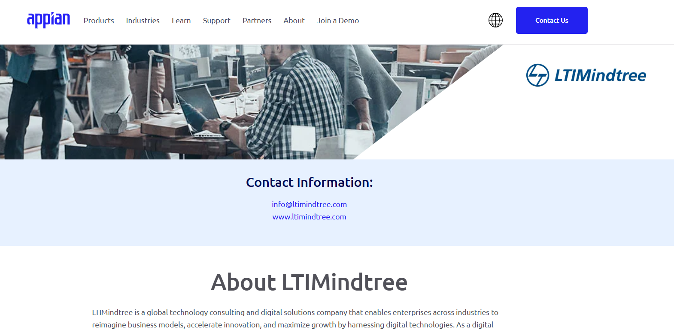
We are the Appian Partner

Slide 14
Our Unique Value Proposition
Exhibit Appian AI Capability
Deliver MVP
Deliver EUC (Excel / VB) Remediation
Operationalize POD
Elevate Enterprise
Accelerate Craft
Compute Revive
Govern360
Accelerate AI Journey of an Enterprise in Weeks rather than Months
Deliver values to business within 3 Months
Remediate your EUC in 40% faster
Establish Appian Delivery POD in 2 Months, COE POD In 4 Months
Leveraging our AI ToolKit & Appian Lab
Using structured Design Workshops & Applify.AI
Using EUC Remediation Approach and Complete Care Services
Using COE Governance framework, structured recruitment and enablement framework
How We can Help
Solution-ize your idea with our expert pool of resources
Early adoption of new feature of Appian by leveraging Appian partnership
Flexible engagement model for simplifying operational process
Agile Service delivery approach to accommodate early feedbacks
Global Delivery Model for 24x7 of Services backed by Best Practices and Process Assets
Defined Enablement framework to scale
Dedicated Recruitment Team to recruit new expert talent
Ensure Quality governance leveraging dedicated Quality Team

Slide 15




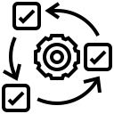

Focus on Accelerators & Frameworks
LTIM is a Professional Services Partner with Appian & also a Reseller Partner
ROI Calculator
Onboarding Co-Pilot
Applify.ai
Risk & Control Governance
AI Starter Kit
Calculates ROI of Appian solution
Indicates business benefits
Provides recommendations
AI driven Co-Pilot
Defines products and generates intake forms
Accelerates Onboarding
App build simplified infusing GenAI with low code
Convert requirement docs into workflows
Framework for EUC remediation
Helps in classifying EUC actions
Facilitates easy prioritization
AI driven classification of Mail and Document
Data extraction of different Form
Intelligent automatic handling of request
LTIM has a dedicated Appian Lab to develop solutions & perform R&D activities
Readily available industry standards, processes and best practices for successful Appian implementations
Best practices, templates & frameworks that can
save 30% BPM SDLC efforts
Notes:
Applify.AI App build simplified infusing GenAI with low code. Convert requirement docs into workflows.
AI Starter Kit for Mail Automation - AI driven classification of Mail and Document. Data extraction of different Form
Intelligent automatic handling of request.
Onboarding Co-Pilot - AI driven Co-Pilot. Defines products and generates intake forms. Accelerates Onboarding
Smart Fit Assessment - Gen AI infused Appian fitment analysis and ROI calculator

Slide 16







Our Appian Services
Experience Connect
AI Innovate
For integration within the experience ecosystem, focusing on seamless user experience, connectivity and integration
For prototype development, emphasizing innovation and cutting-edge solutions like AI
Complete Care
Synergy
For managed service-based delivery, emphasizing comprehensive implementation, care and management
For multi-vendor scenarios, highlighting collaboration and synergy delivering assigned set of work.
Support Plus
Modernize
For support projects, indicating enhanced support and continuous improvement.
Modernize Appian platform by upgrading to latest cloud native Appian version
Re-Invent
Guide Customer using process consulting capabilities to redefine and automate Business Processes to bring value @ scale

Slide 17
Our Appian Offering
Elevate Enterprise - Reimagine Process Automation embracing GenAI
Accelerate Craft - Accelerate Application build using Applify.AI
Compute Revive - EUC Remediation using Appian
Not just Automation, but AI powered Automation to process Intricate Documents using LTIM Appian AI Starter Kit
Build your next generation Application in record speed using GenAI based accelerator Applify.AI.
Re-Invent Business Process backed by Experience Connect to redefine user journey to remediate EUCs.
90% Reduction in Manual Processing
40% Reduction in AI Journey with Starter Kit
30% Reduction in Application Build
40% Savings in process discovery using Applify.AI
40% increase in Operation Efficiency
60% reduction in manual and redundant processes
Appian Launch Pad - Bring Appian to your Enterprise
Appian Govern360 - Establish governance through Appian CoE
Adopt Appian to deliver continuous value to Business In record speed.
Bring Reusability, Scalability, Governance, End to End Ownership, Continuous Improvements and better Collaboration by establishing Appian CoE.
Deliver MVP in 3 Months
Operational POD in 2 Months
40% Savings through reusability
20% Delivery Cost Reduction

Slide 18




Elevate Enterprise
90% Reduction in Manual Processing
40% Reduction in AI Journey with Starter Kit
Reimagine Process Automation embracing GenAI using Appian Platform
Structured execution model to overcome AI adoption challenges
Elevate AI Workshop for in depth mind sharing session for identification of best use-case
Elevate AI Starter ToolKit harnesses the power of AI with configurability to accelerate AI adoption
Automatic handling of incoming request (Emails with Attachment) using AI
Automatic verification of NIGO Scenario
Orchestration of AI skills to automate manual flow
Intelligent routing of request based on smart classification
90%, Reduction in manual processing
3x Speed in Processing
4x reduction in extraction times
LTIM Elevate AI Starter Kit
Document / Email Processing
GenAI Prompt Builder
Summarization
Co-Pilot
Not just Automation, but AI powered Automation to process Intricate Documents using LTIM Appian AI Starter Kit
Appian AI provides capabilities of AI with Low Code experience to automate end to end manual process in record time leveraging different AI Skills induced inside Hyper-Automation capabilities. Built on Appian Low Code platform, Appian AI harnesses the power of AI to automate traditional Process with record speed of delivery.
Make your mundane process intelligent in record speed!
Mail Automation
Appeal Handling
Smart Claim Processing
Contract Analysis

Slide 19

Accelerate Craft
Accelerate Application build using Applify.AI Using Appian Platform
30% Reduction in Application Build
40% Savings in discovery using Applify.AI
Design Thinking Workshop
Leverage GenAI to understand the business requirements
Create Business Process with few clicks using GenAI
Rapid build of User Experience using Low Code
30% Reduction in App Building
Deliver MVP in 3 months
40% Faster realization of Business Requirements
New Application Build
Legacy Application Migration
EUC Remediation
Accelerate Innovation with Rapid Development using Applify.AI
Accelerate your digital transformation with Applify.ai and Appian composer — the fusion of low code development and Generative AI for innovative software solution in record time. Remediate End User Computing Applications with Unified Low Code Platforms.
Build your next generation Application in record speed!
Appian Composer
Applify.AI
Appian Co-Pilot
Structured Approach
Design Thinking

Slide 20
Key Appian Success Stories

Slide 21









Appian COE setup for a large US Bank
Client Challenges
What LTIMindtree Did
  Lack of thought Leadership and Governance
  Prioritization of the use cases
  Non-alignment to Org strategic initiatives
  Lack of Scalability and Efficiency
  Non-adherence to Standards and Best practices
  Longer cycles for Skill Development & upliftment
Appian COE was setup
to streamline use case prioritization and governance
COE defined various processes to address the client challenges on skill development, standardization and reusability
Benefits
Industry – BFSI
  20%
  40%
  18+
  Delivery Cost Reduction
  Savings through reusability
  Processes Automated
Technologies – Appian, SQL Server, Client custom tools
Employees – 5,000+

Slide 22




Process Compliance and Auditing Solution For A Leading Media & Entertainment Giant
Client Challenges
What LTIMindtree Did
  40,000+ Facilities across 200+ countries producing customer branded products
  Lack of monitoring and traceability across the onboarding process and compliance to International Labor Standards
Implemented an Appian based solution to handle the entire Auditing lifecycle
Company & facility onboarding, starting production, conducting periodic audits & related actions.
Benefits
Company & facility onboarding, starting production, conducting periodic audits & related actions.
  1000+
  24 x 7
  40%
Industry –
Media & Entertainment
  Users Globally
  Platform and Solution Support
  Efficiency through Automation
Technologies –
Appian, Selectica EDH

Slide 23




Global Logistics Portal for a Swedish Automotive Manufacturer
Client Challenges
What LTIMindtree Did
  Multiple discrete systems for Material Planning & Procurement
  Lack of a single user interface for end-to-end procurement process execution
  Multiple manual & redundant steps
Appian based solution to interact with multiple systems.
Created 3 modules to handle Material Planning & Procurement Process – Buffer Handling, Warning Handling and Shortage Handling.
Benefits
Developed integration mechanism to fetch data from multiple sources.
  60%
  Single Unified view of Data
Industry –
Automative Manufacturing
  Reduction in Manual and redundant processes
Technologies –
Appian
  Ability to create dynamic dashboards
  & reports
Employees – 800+
Notes:
Scania

Slide 24

Mail Automation using Appian AI for one of the largest Investment Management Organization
Client Challenges
What LTIMindtree Did
  Miss classification of Email and Document
  Lack of end to end traceability of request
  Multiple manual & redundant steps
  Severe backlog of Mails.
Appian based solution to classify the Email with Attachments and extract details.
Leverage Appian AI Starter Toolkit with Appian Skill (Document Classification, Document Creation, Email Classification, Email Extraction, Gen AI etc.).
Projected Benefits
Developed integration mechanism to fetch data from multiple sources.
  80%
  Classify 90% of the Emails and Document automatically
Industry –
Banking
  Reduction in Manual and redundant processes
Technologies –
Appian
  Auto verification of Document and identify NIGO Scenarios
Employees – 7500+
Notes:
Capital Group

Slide 25
Getting to the
future, faster.
Together.

Slide 26


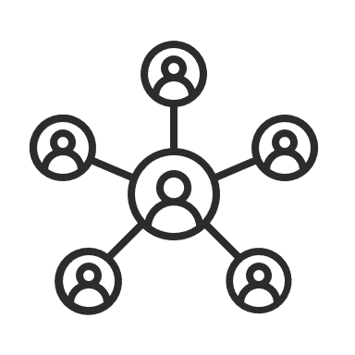
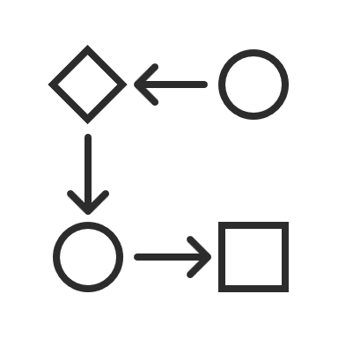





Appian’s Critical Capabilities
  Unify data across systems to build
  powerful applications.
Data Fabric
  Automate anything with integrated workflow, RPA, AI, IDP, and
  API integration.
Automation
  Engage internal and external users across web and mobile experiences.
Total Experience
  Discover process inefficiencies and optimize business outcomes.
Process HQ
AI / ML
  Induce AI using inbuilt AI Skills, Business Co-Pilot and Developer Co-Pilot
Low-Code
  Enabling business and IT with fast speed to solution through intuitive controls.
Unified
  Integrated solution reducing training times and dependence on additional tools.
Enterprise-Grade
  Highly reliable, scalable, and secure architecture for demanding applications.

Slide 27


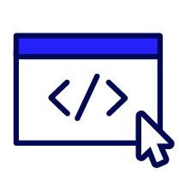













Tenets of critical capabilities
Data Fabric
Automation
Total Experience
Process HQ
Discover data
Orchestrate workflows
Design low-code UX
Discover patterns
Unify data
Enforce policies
Operate on web/mobile
Check for conformance
Secure data
Automate systems
Engage all users
Identify root cause
Optimize data
Process intelligently
Deploy with confidence
Act on insights

